Slide 1
Multi-Year Strategic Planning
Wednesday, March 23, 2022
5 p.m. - 8 p.m.

Slide 2
Land Acknowledgement
We here in the Durham Region respectfully acknowledge that we are on the traditional lands of the Mississaugas of Scugog Island.

Slide 3
Opening Prayer
Father, as we gather together today, we are charged with finding a path to the future that will best serve the needs of the very precious gift that you have entrusted to our care, our students.
Release us from the burden of our own egos. Give us eyes to see things not only as they are but as they should be, ears to hear all the voices, from the margins no less than from the center; hearts to listen to the needs, hopes and dreams of all whom we are called to lead and serve.
O Holy Spirit, come and abide with us. Enliven us with your creative power; inspire us with your wisdom and understanding; Warm us with your love, so that we may live what we profess to believe and serve others with generous and cheerful hearts.
We make our prayer in Jesus’ name.
Adapted from the OCSOA Prayer

Slide 4
MYSP Committee Workshop
5:30pm – 8:00pm
Adult Learning Model
Content For This Evening
Who are we?
Why are we here?
What are we going to do?
How are we going to do it?

Slide 5
WHO ARE WE?

Slide 6
Members
Data Analyst
Yolanda Marshall
Partner and Community Representatives:
Kristin Adamcewicz, APSSP
David Dubowits, Chaplains
Melissa Vickery, CPCO Elementary
Paula Sorhaitz, CPCO Secondary
John Quarrie, CUPE Custodial/Maintenance
Maureen Cope, CUPE Educational Assistants
Sajida Aaron, CUPE LINC/ESL
Mike Morris, CUPE Secretarial/Clerical/Technical
Kelly Mulville, ETFO/DECE
Lori Jones, Management Administrative Group
Anita Cherayil, OECTA Elementary
Paul Collicutt, OECTA Secondary
Valerie Adamo, Special Education Advisory Committee
Vanessa Asgarali, Durham Catholic Parent Involvement
Julie Pigeon, Indigenous Education Circle
Sean McCormack, ABR & BE
Nicole Emanuel, ABR & BE
Kelly Stephen, 2SLGBTQ+
Katherine Mustachi, Faith Formation
Diane Mullane, Mental Health Lead
Luetasha Watkins, Childcare Partners
Co-Chairs:
Morgan Ste. Marie, Chair of the Board
Tracy Barill, Director of Education
MYSP Facilitator:
Lewis Morgulis, L&C Planning Consultants
Communications:
Amanda Roffey, Faeron Pileggi, Emily McCall
Trustees, Clergy and Senior Admin:
John Rinella, Vice Chair of the Board
Monique Forster, Trustee
Janice Oldman, Trustee
Mikhail Yurkoski, Trustee
Declan Amaral, Student Trustee
Sophie Nwaoha, Student Trustee
Fr. Keith Callaghan, Archdiocese of Toronto
Mariah O’Reilly, Superintendent of Education, Academic
Scott Grieve, Superintendent, Corporate

Slide 7
This or That?
DIRECTIONS:
Gather in the Center of the Room
Two options will be given – pick the one that most speaks to you.
Move to the corresponding side of the room.
In groups of two or three:
Introduce yourself
Share why you picked the side you are on
Notes:
City or Country?
Small Families or Big Families?
Staycation or Destination?
Early Riser or Night Owl?

Slide 8
WHY ARE WE HERE?

Slide 9
Why Are We Here?
Ontario Education Act, section 169.1(1)
Every board shall develop a multi-year plan aimed at:
promoting student achievement and well-being;
a positive school climate that is inclusive and accepting of all pupils,
the prevention of bullying and
the delivery of effective and appropriate education to its pupils.

Slide 10
Discovery 2023: Renewing the Vision
Developed in the Spring of 2019
Covers the period of 2019- 2022 (comes to conclusion in December)

Slide 11
Motions of the Board – February 28, 2022
“THAT the Durham Catholic District School Board approve the formation of a planning committee to oversee the development of a Durham Catholic Multi-year Strategic Plan to take effect beginning in January 2023.”
“THAT the Multi-year Strategic Planning Committee be led by the Chair of the Board and the Director of Education and comprised of trustees and designated student, staff and community partner representatives.”
“THAT the mandate of the Multi-year Strategic Planning Committee will be to provide oversight and input into the planning process; ensure opportunities for student, staff and community engagement; provide feedback at key intervals and review the final draft plan to be recommended to the Board for approval.”

Slide 12
WHAT ARE WE GOING TO DO?

Slide 13
Mandate of the MYSP Committee
Lead by Chair Ste. Marie and Director Barill, the mandate of the Multi-year Strategic Planning Committee will be to:
provide oversight and input into the planning process;
ensure opportunities for student, staff and community engagement;
provide feedback at key intervals; and
review the final draft plan to be recommended to the Board for approval.

Slide 14
Role of Senior Administrative Team
Working committee ultimately responsible for development of the key themes, goals and format of the renewed Multi-year Strategic Plan
Representatives of Senior Admin on the MYSP Committee
Will develop the plan and bring forward information for discussion and feedback from the MYSP Committee based upon a thorough review of:
Internal and External Data Analysis
Ministry priorities, funding allocations and local needs
Community and Partner Engagement and Feedback

Slide 15
Role of the Board of Trustees
Ultimately the Board of Trustees is the governing body of Durham Catholic District School Board.
Trustees will keep apprised of the multi-year strategic planning process through regular reports to Board
Final approval of the new Multi-Year Strategic Plan rests with the Board of Trustees

Slide 16
Supports for the Process
Process Facilitator and Consultant
Lewis Morgulis – L&C Planning Consultants
Communications Department
Amanda Roffey, Senior Manager
Faeron Pileggi, Communications Officer
Emily McCall, Digital Media
Data Analyst
Yolanda Marshall
Community Engagement and Feedback
Thought Exchange

Slide 17
WHY DO WE PLAN?

Slide 18
Ultimately, ...we want to ensure the success and well-being of every student

Slide 19
WHAT IS A STRATEGIC PLAN?
What are the things that we must consider in building the plan?

Slide 20
A Strategic Plan is a framework that:
engages communities in conversations about education
is a driver for positive change in the board
acts a guide for the board of trustees and senior administrators
details priorities to allocate the board’s resources

Slide 21
A Strategic Plan is a framework that:
creates a shared vision for staff, students, parents and the community
gives every level of the organization a sense of purpose
illustrates to stakeholders how decisions are made
promotes human rights and ensure equity in achievement and well-being

Slide 22
WHAT ELSE SHOULD OUR PLAN DO?
Take some time to add other important elements

Slide 24
WHO ELSE IS BUILDING PLANS?
Where can we find other strategic plans around us?

Slide 25
Other Organizations Strategic Plans
Region of Durham
City of Oshawa
Town of Whitby
Town of Ajax
Township of Scugog
Ontario Tech University
Trent University
Durham College
Grandview Kids
Durham Community Development Council
Lakeridge Health
Catholic Family Services
Durham Children's Aid
Metrolinx
Durham Region Police Services
Pickering Public Library
Community Care Durham
Whitby Public Library

Slide 26
HOW ARE WE GOING TO DO IT?

Slide 27
The Multi-year Strategic Planning Process

Slide 28
Phase One – Getting Organized
Who will be involved?
Mandate of MYSP Committee
Role of Trustees
Role of Senior Admin
Facilitator, Communications, Data Analyst
Students, Families, Staff, Parish and Community Partners
Who else should be represented?
Timelines
Review of Mission, Vision and Values

Slide 29
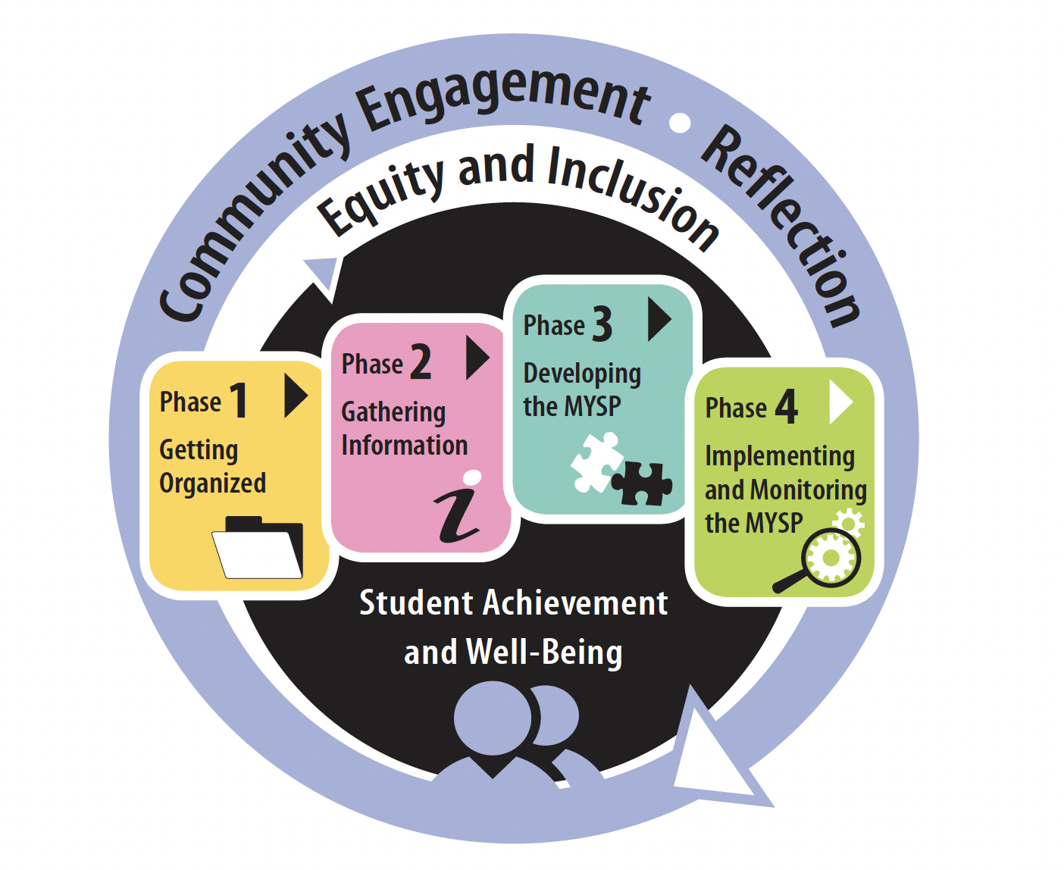
Project Plan
FEB | MAR | APR |  | MAY | JUNE | JULY | AUG | SEPT | OCT |  | NOV | DEC | JAN +
PHASE ONE – Getting Organized
PHASE TWO – Gathering Information
PHASE THREE – Developing the MYSP
PHASE FOUR – Implementing and Monitoring the MYSP

Slide 30
Proposed Timelines
Date | Audience/Participants | Activity
February 2022 | Senior Admin Board of Trustees | Session #1 – February 19, 2022 Report to Board - Establish a Committee – February 28, 2022
March 2022 | MYSP Committee Sr. Admin Working Session | Workshop/Retreat – March 23, 2022 March 30, 2022
April 2022 | Sr. Admin Working Session MYSP Committee Public /Stakeholders | April 5, 2022 April 19, 2022 (5:15pm – 6:45pm) Virtual Information Sharing
May 2022 | MYSP Committee Sr. Admin Working Session Public/Stakeholders | May 16, 2022 (5:15pm – 6:45pm) Virtual May 17, 2022 Community Engagement – May 30, 2022

Slide 31
Proposed Timelines
Date | Audience/Participants | Activity
June 2022 | Sr. Admin Working Session MYSP Committee Public/Stakeholders Sr. Admin Working Session | June 2, 2022 June 13, 2022 (5:15pm – 6:45pm) Virtual Gather Feedback June 22, 2022
July-August 2022 | Communications/Director/Chair/ Facilitator | Content and Format
September 2022 | Senior Admin MYSP Committee Board of Trustees Senior Admin | Review Draft - TBD Review Draft - TBD Review Draft – September 26, 2022 Final Revisions - TBD
October 2022 (Special Board meeting) | Board of Trustees | Final Approval
November /December | Communications | Communications Plan for Roll-out
January 2023 | DCDSB Community | Launch

Slide 32
MISSION, VISION, VALUES
How do we evaluate and reaffirm our Board's Mission, Vision and Values as part of the process?

Slide 33
DCDSB Mission Statement
We are called to celebrate and nurture the God-given talents of each student as we serve with excellence in the light of Christ.

Slide 34
Our Vision
Each student in our Catholic learning community embodies excellence and equity by embracing the Ontario Catholic School Graduate Expectations – to be:
A discerning believer;
An effective communicator;
A reflective, creative and holistic thinker;
A self-directed, responsible lifelong learner;
A collaborative contributor;
A caring family member; and
A responsible citizen.

Slide 35
Our Values
As a Catholic Learning Community, we value:
Faith—evangelizing ourselves and others through scripture, sacrament, prayer and action in service with home, school and parish.
Hope—giving witness to the belief that we can become who we are called to be.
Love—being present to others with care, compassion, solidarity, reconciliation and forgiveness.
Peace—creating opportunities for contemplation, spirituality, reconciliation and forgiveness.
Wisdom—listening and responding to the Holy Spirit.
Inclusion—ensuring a sense of belonging by promoting the dignity and worth of each human life.
Excellence—building on God’s grace to achieve our earthly and eternal vocations.
Creativity—celebrating diverse and innovative expressions of God’s gifts.
Service—seeking out and responding to local and global needs with prudence, fortitude, humility and charity.
Stewardship—shepherding God’s creation and resources for the common good.
Responsibility—demonstrating accountability and fidelity in thoughts, words and deeds.
Justice—acting and serving with integrity in communion with the Gospel and teachings of Jesus.

Slide 36
Mission, Vision and Values
Do our current mission, vision and values reflect our Catholic community?
Do our staff see themselves reflected in our mission, vision and values?
Do our mission, vision and values statements reflect the legislated purpose and goals of publicly funded Catholic Education in Ontario?

Slide 37
Mission, Vision and Values
Do our mission, vision and values reflect our obligations under the Human Rights Code?
Are our statements concise, clear, aspirational and optimistic?

Slide 38
NEXT STEPS

Slide 39
Phase 2 – Gathering Information
STAGE ONE – Data Collection and Analysis
1. Data Collection
Internal scan (What data do we have? What data do we need?)
External Scan (What forces are at play externally?)
2. Data Analysis
Find themes and outliers
Identify tentative strategic priorities

Slide 40
Phase 2 – Gathering Information
STAGE TWO - Formal Stakeholder Engagement
Identify the stakeholders
Determine the engagement approach and questions
Conduct the engagements
Analyze the findings
Find the themes and outliers
Compare the stakeholder feedback to the research data

Slide 41
Future Meetings
Virtual meetings of the MYSP are planned for the following dates from 5:15 p.m. to 6:45 p.m.
April 19, 2022
May16, 2022
June 13, 2022
A final meeting will be scheduled in early September 2022.

