Slide 1
Multi-Year Strategic Planning
MYSP Committee Meeting #3
Monday May 16, 2022

Slide 2
Land Acknowledgement
We here in the Durham Region respectfully acknowledge that we are on the traditional lands of the Mississaugas of Scugog Island.

Slide 3
Opening Prayer
Father, as we gather together today, we are charged with finding a path to the future that will best serve the needs of the very precious gift that you have entrusted to our care, our students.
Release us from the burden of our own egos. Give us eyes to see things not only as they are but as they should be, ears to hear all the voices, from the margins no less than from the center; hearts to listen to the needs, hopes and dreams of all whom we are called to lead and serve.
O Holy Spirit, come and abide with us. Enliven us with your creative power; inspire us with your wisdom and understanding; Warm us with your love, so that we may live what we profess to believe and serve others with generous and cheerful hearts.
We make our prayer in Jesus’ name.
Adapted from the OCSOA Prayer

Slide 4
MYSP Committee Workshop
5:15pm – 6:45pm
Content For This Evening
Welcome
Land Acknowledgement
Opening Prayer
Review of Consultations to Date
Review of Mission and Values
Thought Exchanges
Next Steps

Slide 5
Members
Partner and Community Representatives:
Erin Troost, APSSP
David Dubowits, Chaplains
Melissa Vickery, CPCO Elementary
Paula Sorhaitz, CPCO Secondary
John Quarrie, CUPE Custodial/Maintenance
Maureen Cope, CUPE Educational Assistants
Sajida Aaron, CUPE LINC/ESL
Mike Morris, CUPE Secretarial/Clerical/Technical
Kelly Mulville, ETFO/DECE
Lori Jones, Management Administrative Group
Jackie French, OECTA Elementary
Paul Collicutt, OECTA Secondary
Valerie Adamo, Special Education Advisory Committee
Vanessa Asgarali, Durham Catholic Parent Involvement
Julie Pigeon, Indigenous Education Circle
Sean McCormack, ABR & BE Committee
Nicole Emanuel, ABR & BE Committee
Kelly Stephen, 2SLGBTQ+ Advisory Committee
Katherine Mustachi, Faith Formation
Diane Mullane, Mental Health Lead
Luetasha Watkins, Childcare Partners
Co-Chairs:
Morgan Ste. Marie, Chair of the Board
Tracy Barill, Director of Education
MYSP Facilitator:
Lewis Morgulis, L&C Planning Consultants
Communications:
Amanda Roffey, Faeron Pileggi, Emily McCall
Trustees, Clergy and Senior Admin:
John Rinella, Vice Chair of the Board
Monique Forster, Trustee
Janice Oldman, Trustee
Mikhail Yurkoski, Trustee
Declan Amaral, Student Trustee
Sophie Nwaoha, Student Trustee
Fr. Keith Callaghan, Archdiocese of Toronto
Mariah O’Reilly, Superintendent of Education, Academic
Scott Grieve, Superintendent, Corporate

Slide 6
The Multi-year Strategic Planning Process

Slide 7
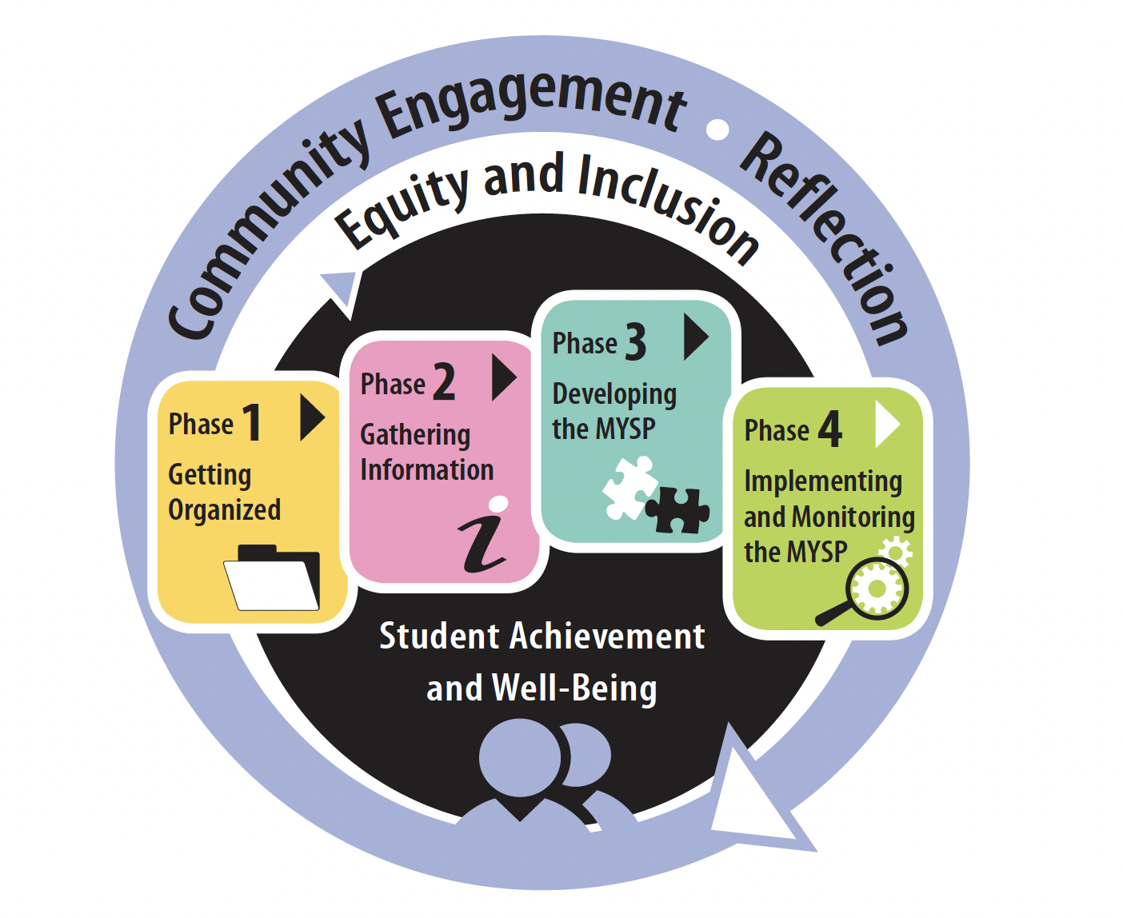
Project Plan
FEB | MAR | APR |  | MAY | JUNE | JULY | AUG | SEPT | OCT |  | NOV | DEC | JAN +
PHASE ONE – Getting Organized
PHASE TWO – Gathering Information
PHASE THREE – Developing the MYSP
PHASE FOUR – Implementing and Monitoring the MYSP

Slide 8
Proposed Timelines
Date | Audience/Participants | Activity
February 2022 | Senior Admin Board of Trustees | Session #1 – February 19, 2022 Report to Board - Establish a Committee – February 28, 2022
March 2022 | MYSP Committee Sr. Admin Working Session | Workshop/Retreat – March 23, 2022 March 30, 2022
April 2022 | Sr. Admin Working Session MYSP Committee Public /Stakeholders | April 5, 2022 April 19, 2022 (5:15pm – 6:45pm) Virtual Information Sharing
May 2022 | MYSP Committee Sr. Admin Working Session Public/Stakeholders | May 16, 2022 (5:00pm – 6:45pm) Virtual May 17, 2022 Community Engagement – May 30, 2022

Slide 9
Proposed Timelines
Date | Audience/Participants | Activity
June 2022 | Sr. Admin Working Session MYSP Committee Public/Stakeholders Sr. Admin Working Session | June 2, 2022 June 13, 2022 (5:00pm – 6:45pm) Virtual Gather Feedback June 22, 2022
July-August 2022 | Communications/Director/Chair/ Facilitator | Content and Format
September 2022 | Senior Admin MYSP Committee Board of Trustees Senior Admin | Review Draft - TBD Review Draft - TBD Review Draft – September 26, 2022 Final Revisions - TBD
October 2022 (Special Board meeting) | Board of Trustees | Final Approval
November /December | Communications | Communications Plan for Roll-out
January 2023 | DCDSB Community | Launch

Slide 10
What have we done since the last meeting?

Slide 11
Public and Staff Consultations
Student Focus Sessions held by school
May 4 – Father Leo J. Austin CSS
May 5 – All Saints CSS
May 5 – Monsignor John Peremya CSS
May 6 – Notre Dame CSS
May 6 – Archbishop Dennis O’Connor CHS
May 6 – St. Mary CSS
May 13 – Monsignor Paul Dwyer CHS

Slide 12
Public and Staff Consultations
May 3 – Special Education Advisory Committee (SEAC)
May 4 - Community Virtual Session (and recording)
May 11 - Staff Virtual Session
May 12 – Durham Catholic Parent Involvement Committee (DCPIC)
May 16 – Catholic Education Centre Staff

Slide 13
Public and Staff Consultations
May 17 - Anti Black Racism and Black Excellence Executive Meeting
May 18 - Staff Drop-in Session (CEC North Boardroom)
May 25 – Staff Drop-in Session (Notre Dame)
June 1 – Indigenous Education Circle (IEC) Meeting

Slide 14
Public and Staff Consultations
Two thought exchanges are underway
DCDSB Mission Statement
Strategic Priorities for the Future
Both exchanges can be accessed at:
https://www.dcdsb.ca/en/our-board/mysp-thoughtexchange.aspx

Slide 15
Input received to date

Slide 16
Exchange Summary
Tracy Barill, Durham Catholic District School Board
April 26, 2022
Please share your thoughts about our ultimate purpose, what we do, and who we are called to serve.

Slide 17
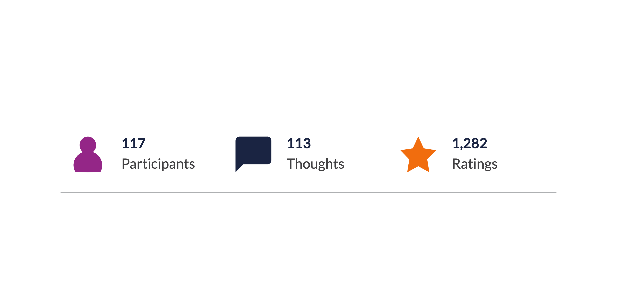
PARTICIPATION
Breakdown of Participation

Slide 18
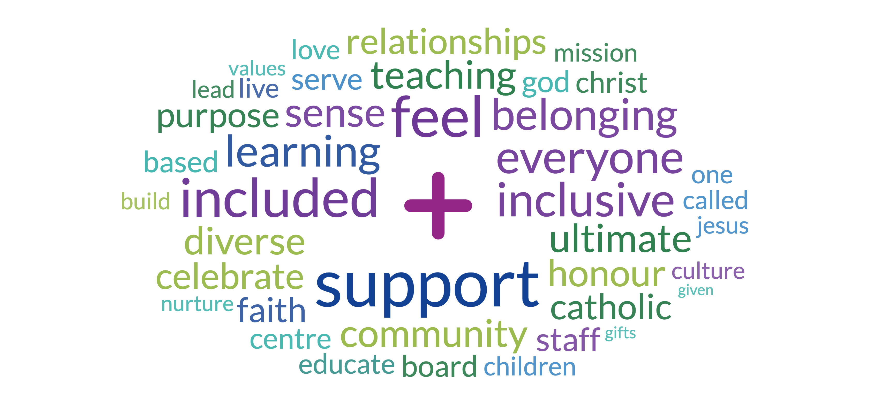
WORDCLOUD
Top Rated

Slide 19
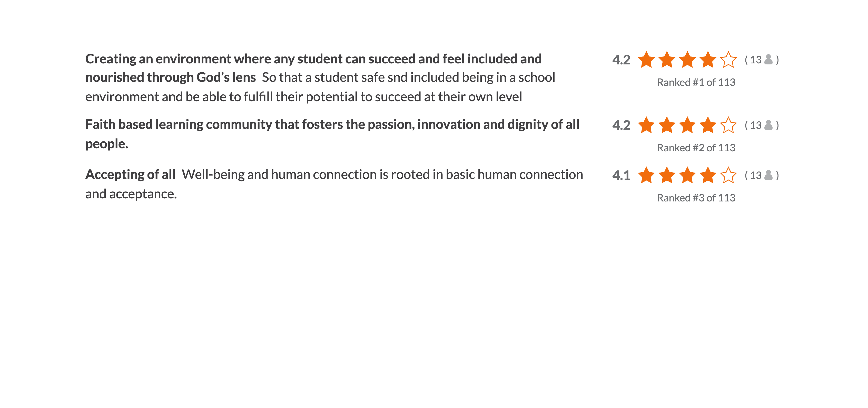
THOUGHTS
Key Thoughts

Slide 20
THOUGHTS
Staff Feel

Slide 21
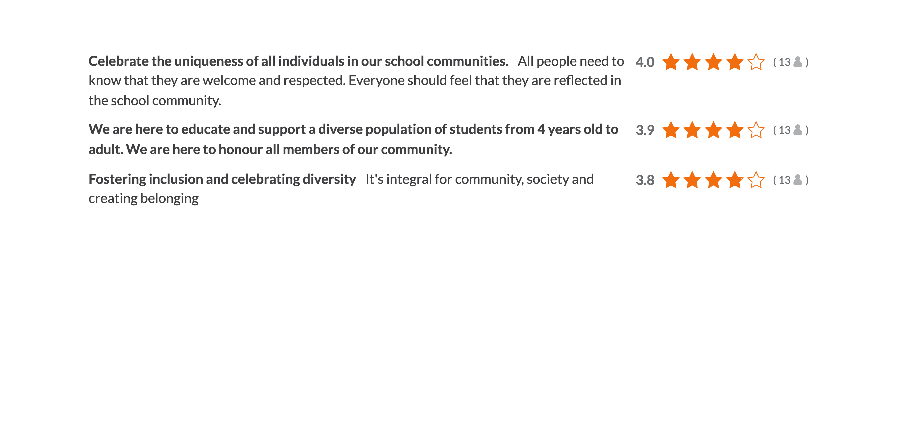
THOUGHTS
Community

Slide 22
THOUGHTS
Miscellaneous

Slide 23
MISSION, VISION, VALUES
How do we evaluate and reaffirm our Board's Mission, Vision and Values as part of the process?

Slide 24
DCDSB Mission Statement
We are called to celebrate and nurture the God-given talents of each student as we serve with excellence in the light of Christ.

Slide 25
Breakout Activity
Please join the zoom breakout room to discuss the Mission and Values for the next 25 minutes

Slide 26
In your groups craft a mission statement that we can use:

Slide 27
In your work please consider the following words …

Slide 28
Faith
Education
Inclusivity

Slide 29
Mission Statement Review
We will look at all of the draft statements and blend them together to be presented at our June Meeting

Slide 30
Mission Statement Review
The goal is to craft a wording for the mission statement that we can place into a thought exchange for broader review

Slide 31
NEXT STEPS

Slide 32
Future Meetings
Meetings of the MYSP are planned for the following dates from 5:00 p.m. to 6:45 p.m.
June 13, 2022
A final meeting will be scheduled in early September 2022.

