Slide 1
Multi-Year Strategic Planning
MYSP Committee Meeting #4
Monday June 13, 2022

Slide 2

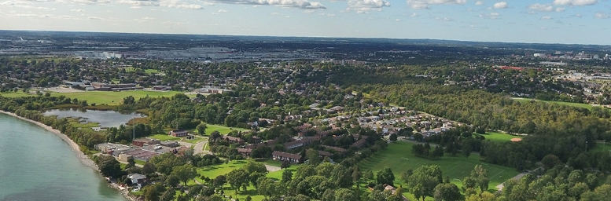
Land Acknowledgement
We here in the Durham Region respectfully acknowledge that we are on the traditional lands of the Mississaugas of Scugog Island.

Slide 3


Slide 4
Opening Prayer
O Jesus,
Through the Immaculate Heart of Mary, I offer you my prayers, works, joys
and sufferings of this day for all of the intentions of your Sacred Heart, in
union with the holy sacrifice of the Mass throughout the world,
in thanksgiving for your favours, in reparation for my sins, for the
intentions of all my relatives and friends, and in particular for the
intentions of the Holy Father.
Amen

Slide 5
MYSP Committee Workshop
5:00pm – 6:45pm
Pope Francis Center
Content For This Evening
  Welcome
  Land Acknowledgement
  Opening Prayer
  Review of Timelines and Progress to Date
  Regional Data Scan
  Mission and Vision
  Next Steps

Slide 6
Members
Data and Research Officer
Richard DeCaires
Partner and Community Representatives:
Erin Troost, APSSP
David Dubowits, Chaplains
Melissa Vickery, CPCO Elementary
Paula Sorhaitz, CPCO Secondary
John Quarrie, CUPE Custodial/Maintenance
Maureen Cope, CUPE Educational Assistants
Sajida Aaron, CUPE LINC/ESL
Mike Morris, CUPE Secretarial/Clerical/Technical
Kelly Mulville, ETFO/DECE
Lori Jones, Management Administrative Group
Jaci French, OECTA Elementary
Paul Collicutt, OECTA Secondary
Valerie Adamo, Special Education Advisory Committee
Vanessa Asgarali, Durham Catholic Parent Involvement
Julie Pigeon, Indigenous Education Circle
Sean McCormack, ABR & BE Committee
Nicole Emanuel, ABR & BE Committee
Kelly Stephen, 2SLGBTQ+ Advisory Committee
Katherine Mustachi, Faith Formation
Diane Mullane, Mental Health Lead
Luetasha Watkins, Childcare Partners
Co-Chairs:
Morgan Ste. Marie, Chair of the Board
Tracy Barill, Director of Education
MYSP Facilitator:
Lewis Morgulis, L&C Planning Consultants
Communications:
Amanda Roffey, Faeron Pileggi, Emily McCall
Trustees, Clergy and Senior Admin:
John Rinella, Vice Chair of the Board
Monique Forster, Trustee
Janice Oldman, Trustee
Mikhail Yurkoski, Trustee
Declan Amaral, Student Trustee
Sophie Nwaoha, Student Trustee
Fr. Keith Callaghan, Archdiocese of Toronto
Kayode Akomolafe, Human Rights and Equity Advisor
Mariah O’Reilly, Superintendent of Education, Academic
Scott Grieve, Superintendent, Corporate

Slide 7
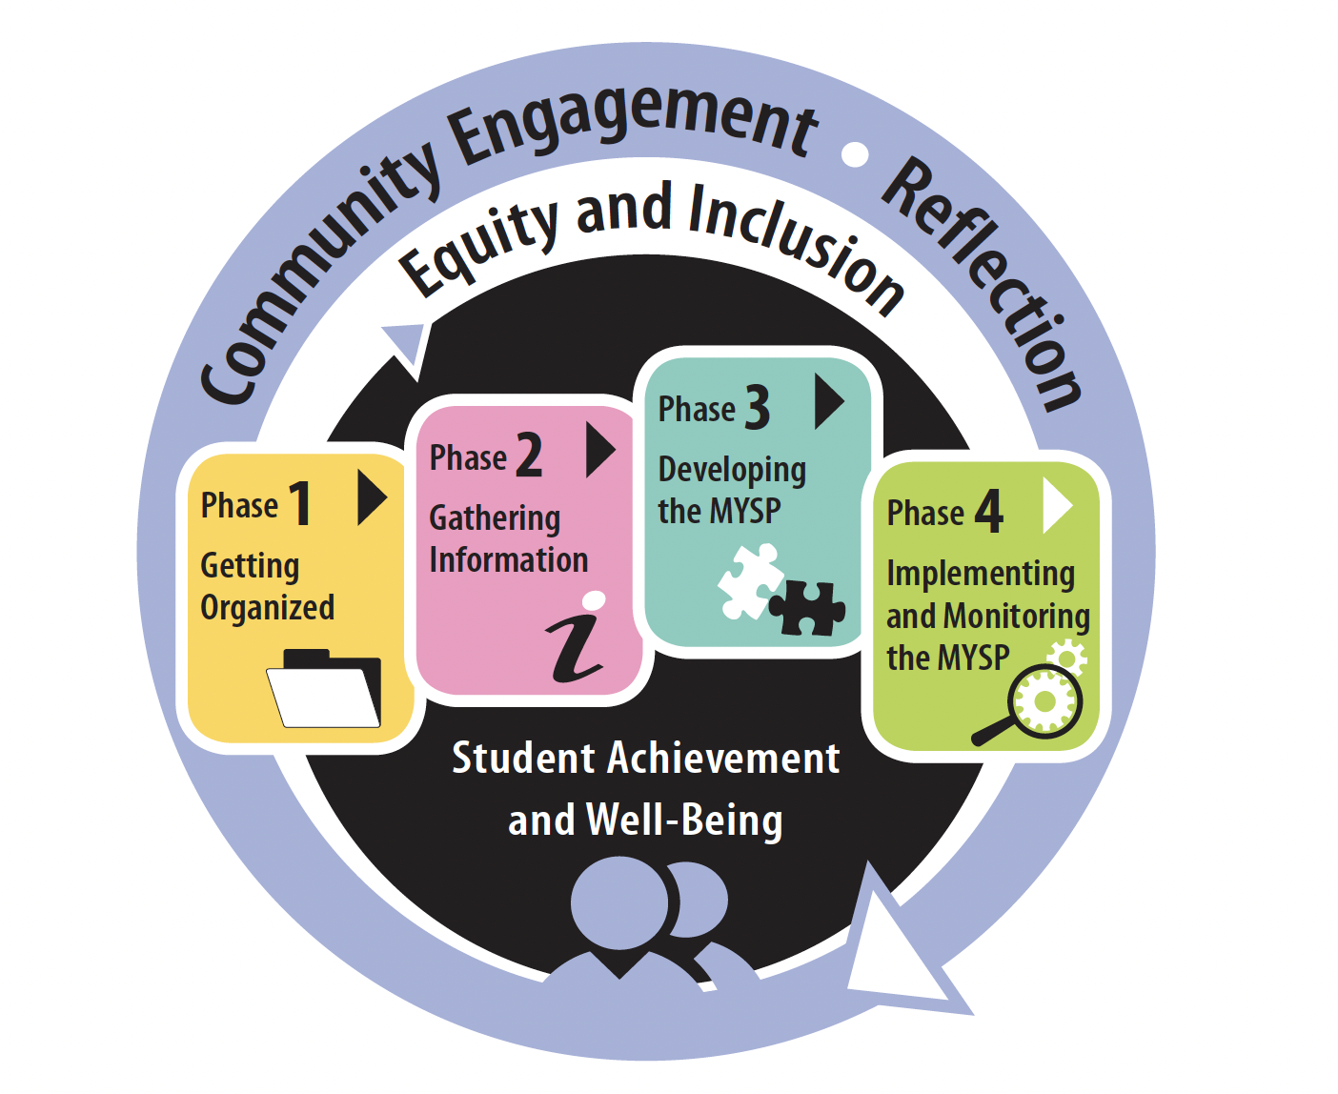
The Multi-year Strategic Planning Process

Slide 8
Project Plan
FEB | MAR | APR |  | MAY | JUNE | JULY | AUG | SEPT | OCT |  | NOV | DEC | JAN +
PHASE ONE – Getting Organized
PHASE TWO – Gathering Information
PHASE THREE – Developing the MYSP
PHASE FOUR – Implementing and Monitoring the MYSP

Slide 9
Proposed Timelines
Date | Audience/Participants | Activity
February 2022 | Senior Admin Board of Trustees | Session #1 – February 19, 2022 Report to Board - Establish a Committee – February 28, 2022
March 2022 | MYSP Committee Sr. Admin Working Session | Workshop/Retreat – March 23, 2022 March 30, 2022
April 2022 | Sr. Admin Working Session MYSP Committee Public /Stakeholders | April 5, 2022 April 19, 2022 (5:15pm – 6:45pm) Virtual Information Sharing
May 2022 | MYSP Committee Sr. Admin Working Session Public/Stakeholders | May 16, 2022 (5:15pm – 6:45pm) Virtual May 17, 2022 Community Engagement – May 30, 2022

Slide 10
Proposed Timelines
Date | Audience/Participants | Activity
June 2022 | Sr. Admin Working Session MYSP Committee Public/Stakeholders Sr. Admin Working Session | June 2, 2022 June 13, 2022 (5:15pm – 6:45pm) In Person Gather Feedback June 22, 2022
July-August 2022 | Communications/Director/Chair/ Facilitator | Content and Format
September 2022 | Senior Admin MYSP Committee Board of Trustees Senior Admin | August 18/19, 2022 – Review Draft September 12, 2022 – Review Draft Review Draft – September 26, 2022 Final Revisions
October 2022 (Special Board meeting) | Board of Trustees | Early October - Final Approval
November /December | Communications | Communications Plan for Roll-out
January 2023 | DCDSB Community | Launch

Slide 11
What Have we done since the last meeting

Slide 12
What have we done?
Taken stock of our programs and services
Reviewed Internal Data Sources:
  School Pastoral Plans
  School Climate Surveys
  Mental Health
  Special Education Data
  De-streamed Math Achievement Data
  Pathways Data
  Indigenous Education Data
  Workforce Census Data

Slide 13
What have we done?
Identified critical work that needs to be done in the coming years in each area (Ministry, funding, data or mandate driven)
  Focus on adult faith formation and leadership
  De-streaming
  Science of Reading
  Culturally relevant and responsive pedagogy and practice
  Indigenous Education
  Modernization
  Leadership and succession planning
  Re-build community
  Re-establish financial reserves
  Capital Renewal
  Employment Systems Review

Slide 14
What have we done?
External/Environmental Scan
Census/Demographics for Durham Region/Ontario
Strategic Plans for other Boards and Related Agencies
Ministry Priorities
Economic Factors

Slide 15
What have we done?
Offered opportunity for engagement of students, families, staff and community members through:
  Focus Group Sessions
  Virtual Town Hall Meetings
  Staff Drop In Sessions
  Advisory Group Meetings (DCPIC, Student Senate, SEAC, ABR&BE, Indigenous Education Circle, 2SLGBTQ+ Student Summit)
Two thought exchanges during the month of May (1100+ participants and 14700 ratings)

Slide 16


DCDSB
Multi Year Strategic Plan
Regional Data Review
June 2022

Slide 17
Overview
Population data
Age pyramids
Preschool and school aged children
Women aged 20-44 and persons 65+
Housing Data
Income Data
Diversity data
Family Data
Section Break
Insert the Subtitle of Your Presentation

Slide 18
Data Sources
Manifold Data
Their data is modelled based on the Census as well as other current year sources that update more frequently than the Census such as:
Immigration statistics from Citizenship and Immigration Canada.
Income information from tax filer data.
Labour Force Survey and building permit data.
Housing statistics and dwelling value data (including hundreds of thousands of individual listings per year) from Real Estate Associations and Real Estate companies such as Royal LePage.
Numeris Consumer Surveys.
Manifold data covers the Board’s jurisdiction (excludes Clarington)

Slide 19
Data Sources
Ministry of Finance Data
The Ministry of Finance produces an updated set of population projections every year to reflect the most up-to-date trends and historical data. This update uses as a base the 2020 population estimates from Statistics Canada
The Ministry of Finance data includes Clarington as part of Durham Region

Slide 20
Durham Region Data Timelines
Canada Census
Ministry of Finance
End of new MYSP
The last full census data available at present is 6 years old
Population projections released by the Ministry cover a period from 2020 to 2040
The DCDSB MYSP covers 2023 - 2025
2017
2022
2016
2020
2025
Manifold Data
Manifold Data
The first demographic data points available from Manifold for use in the MYSP
The second data points are prepared for 2022 and give us a 5 year window to review

Slide 21
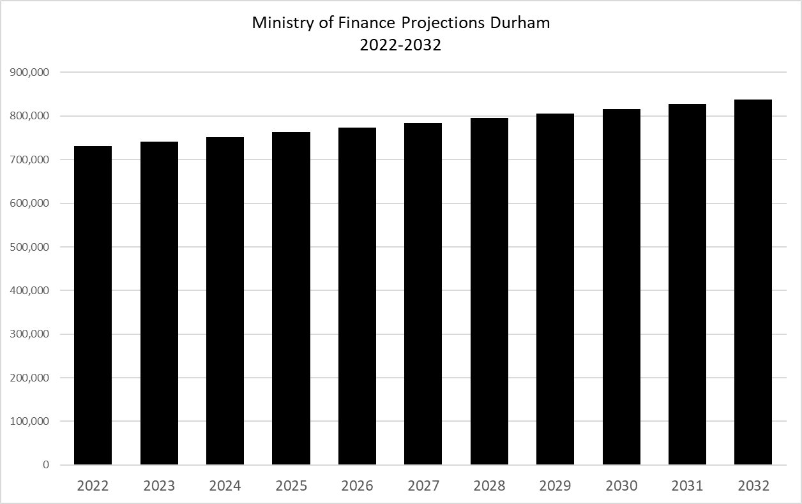
Projected Population
Source Ministry of Finance

Slide 22
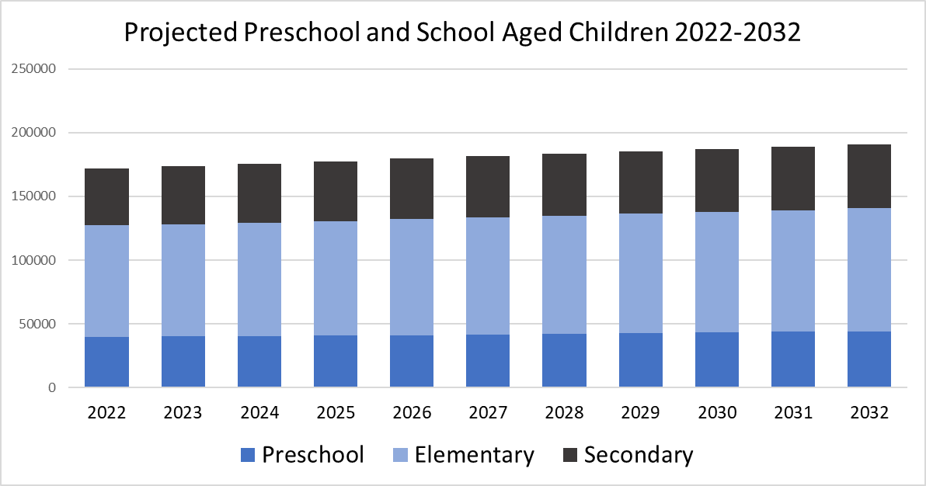
Projected Population
Source Ministry of Finance

Slide 23
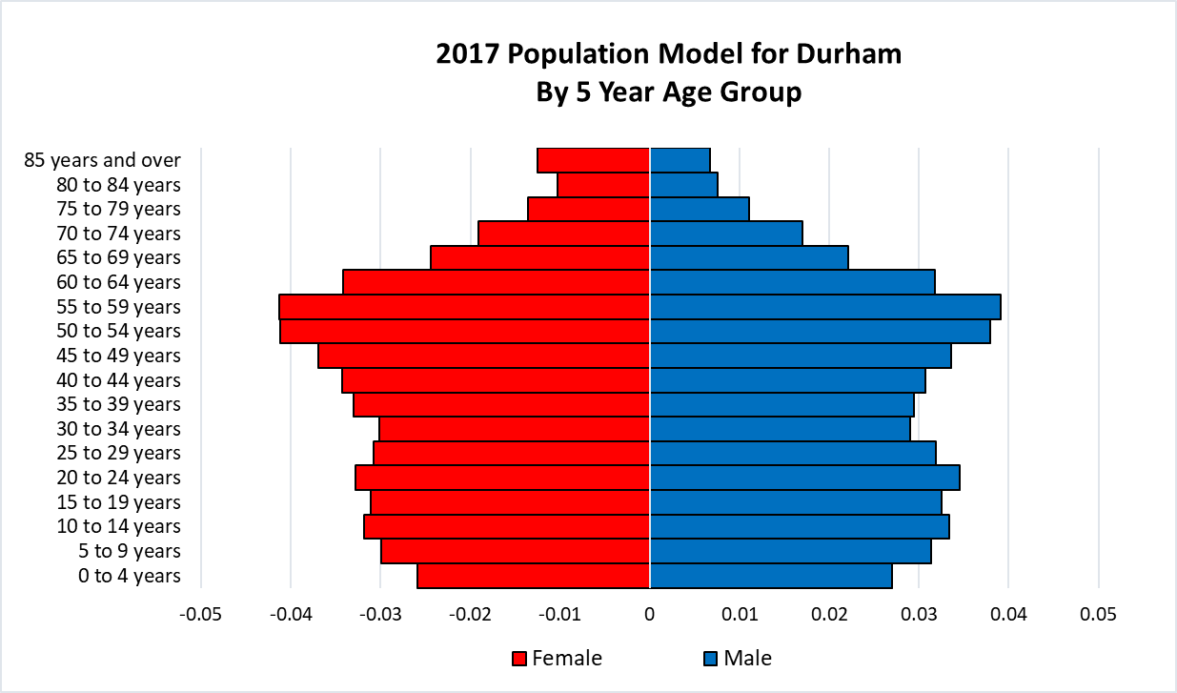
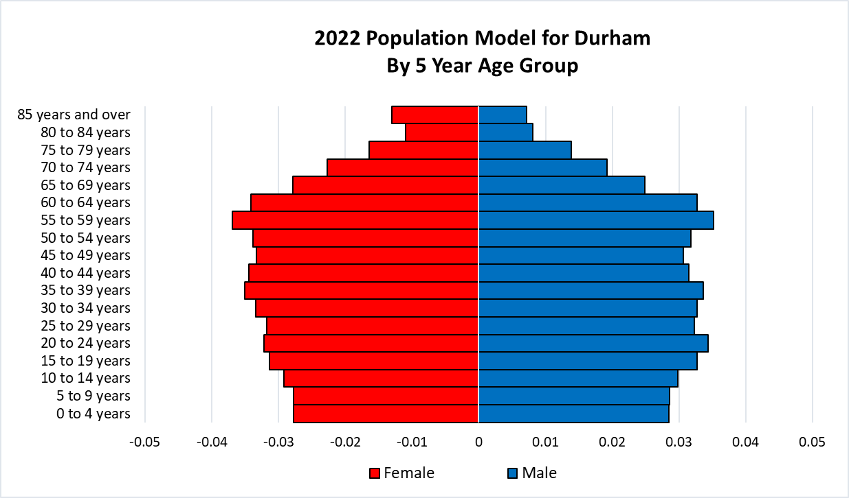
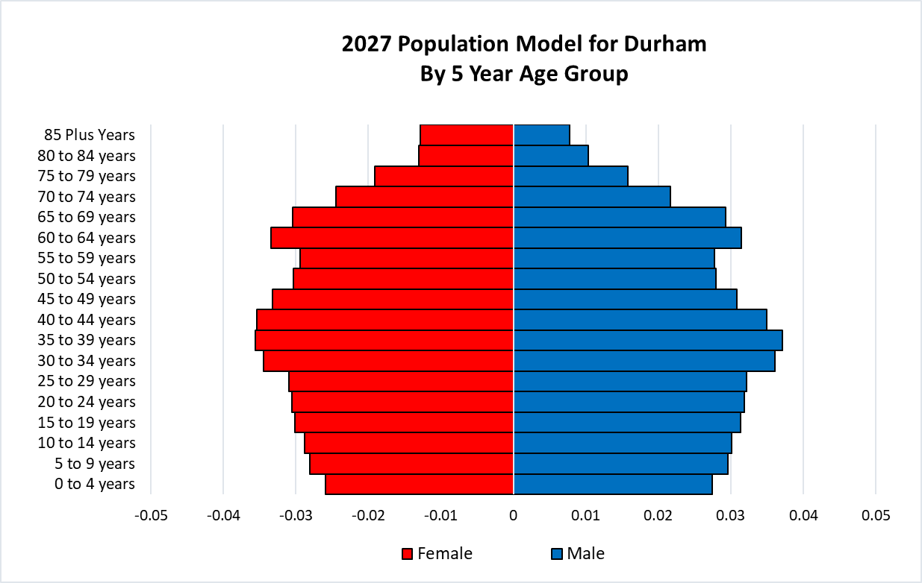
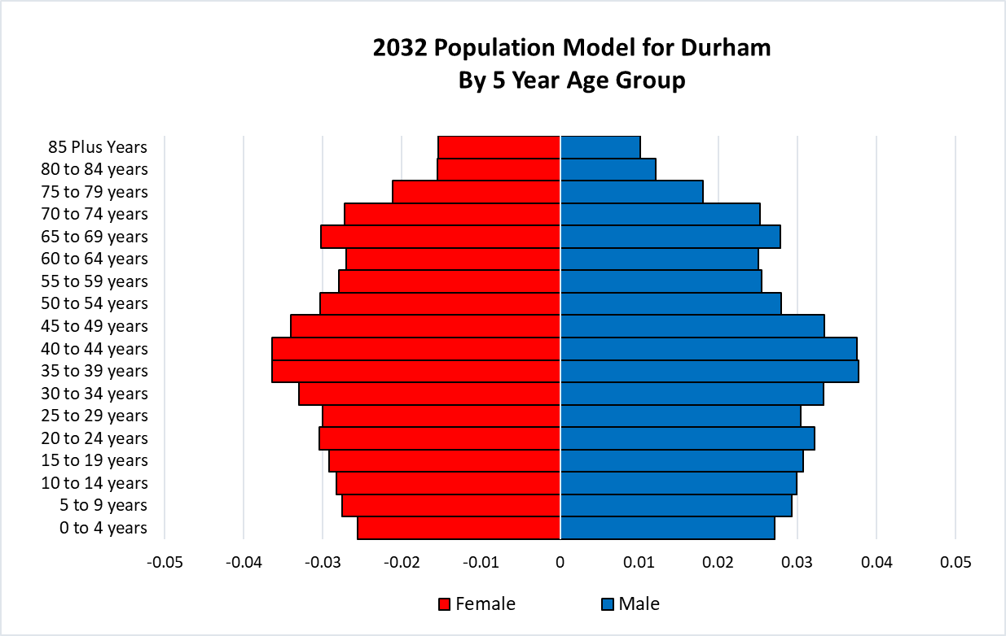
Regional Population Pyramids 2017-2032

Slide 24
Population Graphs
Using the Ministry of Finance projections Durham is projected to grow by 100,000 persons to 2032
The population pyramids indicate that a lot of the growth will be in persons over 40 and the largest cohorts by 2032 will be 35-44 years
Preschool and school aged children will make up a smaller proportion of the population but will still grow over time
The Ministry data does include Clarington

Slide 25
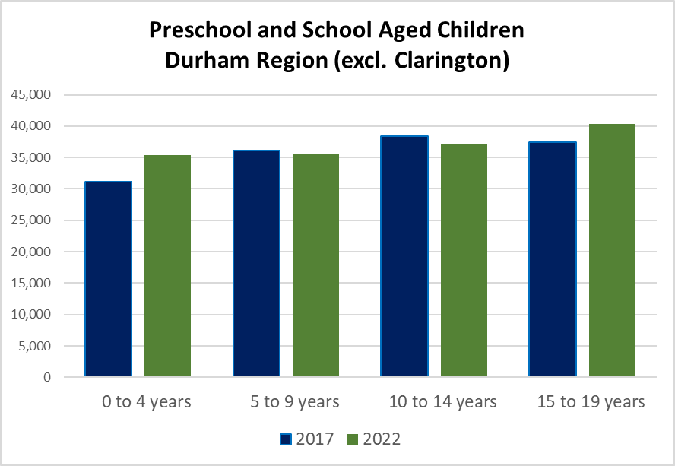
Source Manifold

Slide 26
Impact of School Aged Population
From 2017 to 2022 the preschool population for all Boards in the region grew
Over the same period the Elementary population declined region-wide
In the long term the elementary population will grow from new housing
The preschool population is smaller than the elementary cohorts for both 2017 and 2022

Slide 27
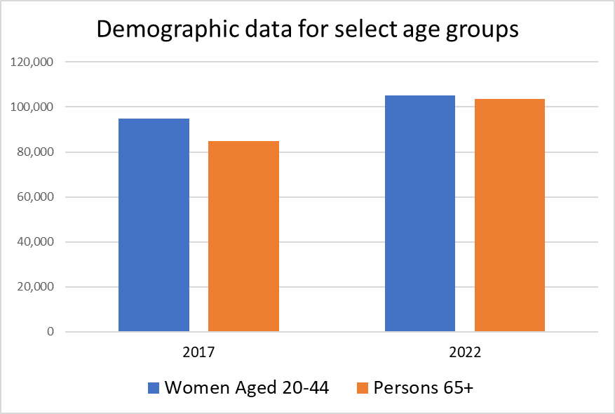
Women aged 20-44 and Seniors 65+
Source Manifold

Slide 28
Women aged 20-44 and Seniors 65+
Both groups grew from 2017 to 2022
The largest issue with the population over 65 is that the vast majority stay in their homes and the lack of enough seniors housing means that residential areas cannot turn over any faster than at present
The growth of Women aged 20-44 means that there is still a large and growing pool from which new children can be born. Ultimately birth rates will impact the number of children within Durham

Slide 29
Housing Data
2022 | Total Dwellings | Single-detached house | Apartment, building that has >5 storeys | Other attached dwelling
Ontario | 5,745,955 | 3,117,372 | 995,306 | 1,616,729
Durham | 216,465 | 140,609 | 16,397 | 59,405
Ajax | 41,269 | 26,626 | 2,139 | 12,498
Brock | 4,987 | 4,293 | 8 | 686
Oshawa | 69,766 | 39,686 | 7,720 | 22,355
Pickering | 35,034 | 21,409 | 3,016 | 10,594
Scugog | 8,501 | 7,568 | 51 | 881
Uxbridge | 8,293 | 6,831 | 92 | 1,358
Whitby | 48,564 | 34,144 | 3,372 | 11,032
Source Manifold

Slide 30
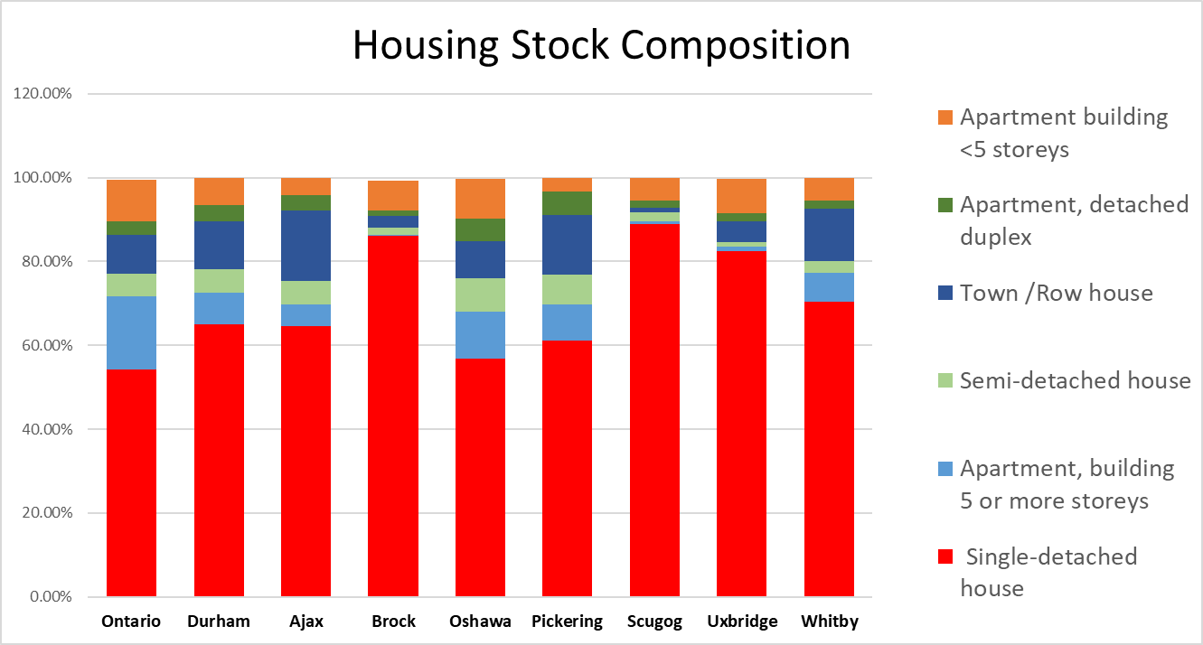
Housing Data
Source Manifold

Slide 31
Housing 2022
Most of the housing in the Region is Single Family housing 65% followed by attached dwellings 27.5% (Row house/Semi-/ Apartment etc.)
Single Family housing is highest in Scugog, Uxbridge, Brock and on the Lands of the Mississauga's of Scugog Island (all over 80%)
Apartments account for 14% of the housing stock in the Region
Under the Planning Act and Provincial Policies more housing must be in denser forms in the future (Row house, Condominium, and Apartments)
Infill developments represent significant opportunities for density increases

Slide 32
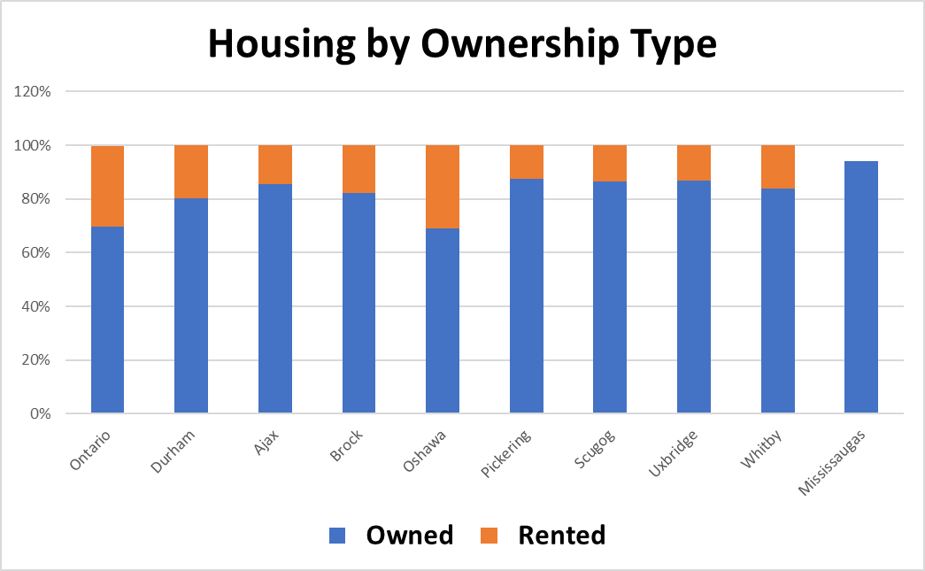
Housing Data 2022
Source Manifold

Slide 33
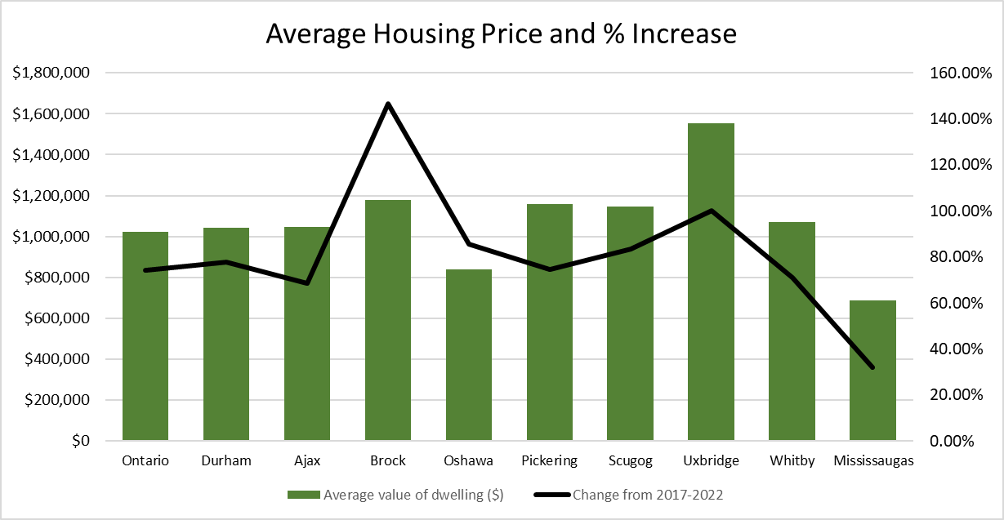
Housing Data 2022
Source Manifold

Slide 34

Housing Cost
The Average increase in Ontario was 74.2% from 2017-2022
The greatest cost increases are in Brock (up 146%) and Uxbridge (up $777,300)
Owning housing is out of reach for many people and even a moderate correction will still leave house costs beyond the reach of many
77% Increase
In Durham
2017-2022

Slide 35
Income Data
Source Manifold

Slide 36
Income Data
The average and median incomes in Durham are higher than the provincial average for 2017 and 2022
The number of persons with $10,000 income or less per year grew from 2017 to 2022 in Durham and particularly in Pickering, Oshawa and Whitby. This may have a correlation to the increasing number of post secondary students, or it may represent more documented poverty

Slide 37
Diversity Data
Ontario Data
70.6% of the province identified as not being a visible minority in 2017 (10,069,750),
In Durham
30.5% of the population or 179,400 persons are a visible minority in Durham Region as of 2017. The number increased in 2022 to 194,700
Ontario Data
29.4% of the province identified as being a visible minority in 2017 (4,187,030), and the rate decreased in 2022 to 29.2% although the absolute number of visible minorities grew to 4,387,123 persons
Town of Ajax
Visible minorities make up 56.9% of the residents in 2017 and 57.2% in 2022, the highest percentage in the Region
Identification
Within Durham 194,700 persons identify as being from a visible minority. The largest groups by population are those who identify as South Asian 63,500 and Black 56,425 persons
Brock, Uxbridge and Scugog
These three communities have the lowest number of visible minorities with 3%, 3.4% and 5.6% in 2017.
Source Manifold

Slide 38
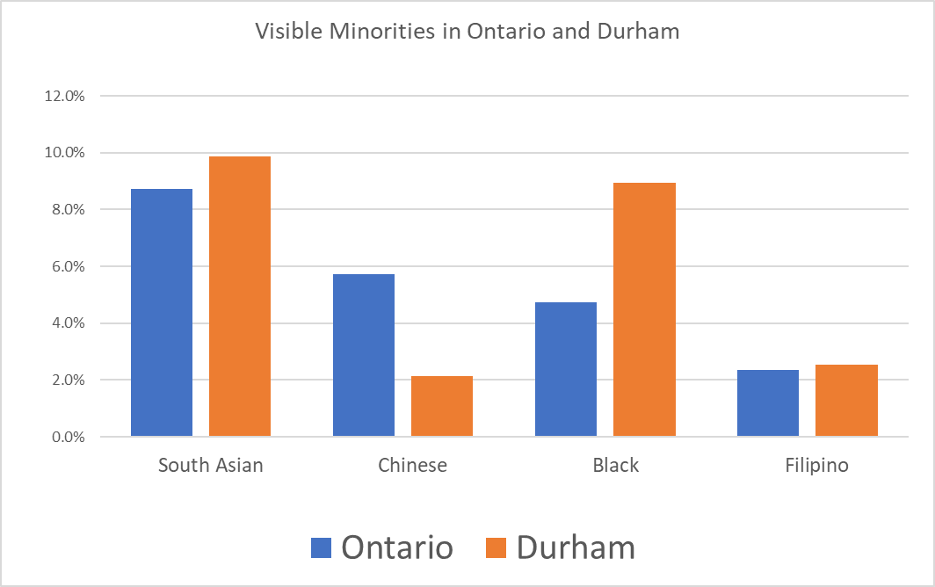
Visible Minorities in Durham and Ontario
Visible minority for the population in private households. Visible minorities are persons, other than Aboriginal peoples, who are non-Caucasian in race or non-white in colour.
Source Manifold

Slide 39
Citizenship Data for 2017 and 2022
Source Manifold

Slide 40
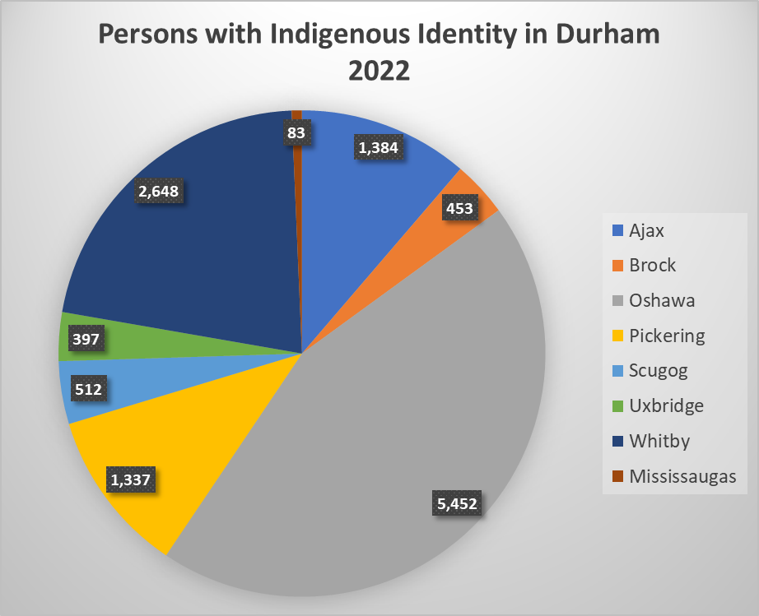
Indigenous Identity
Indigenous identity refers to those persons who reported identifying with at least one Indigenous group, i.e. First Nations, Métis or Inuit
Source Manifold

Slide 41
Growth and Citizenship
The Region experienced population growth from 2017 to 2022
The growth rate in Durham was greater than the average for the balance of Ontario
The greatest growth rate increases were in Oshawa 9.65% and Whitby 7.42%
The growth of non-citizens for Durham 9.89% was much higher than the provincial average and highest in the City of Oshawa at 22.23%

Slide 42
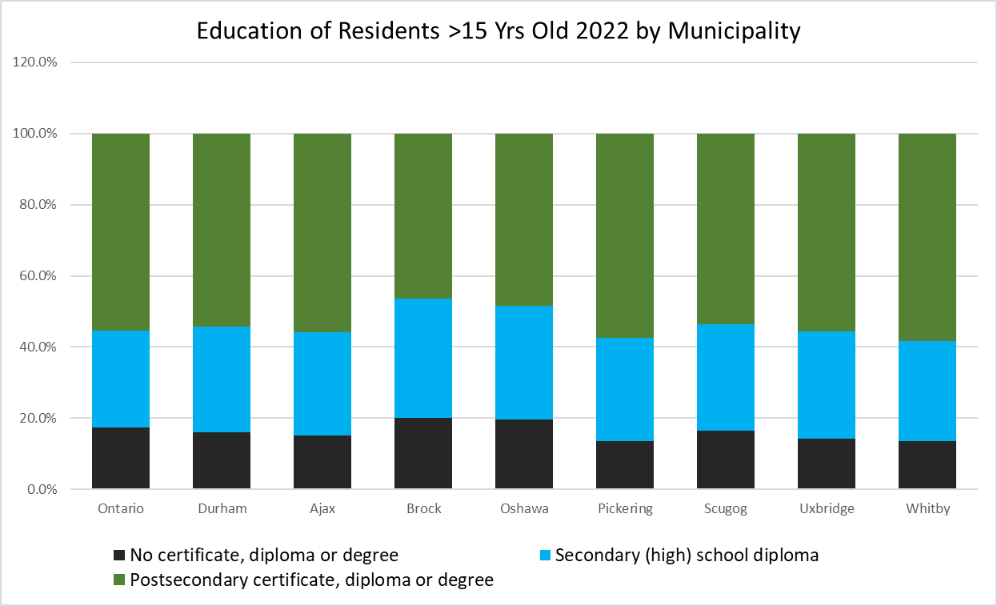
Education Data
Source Manifold

Slide 43
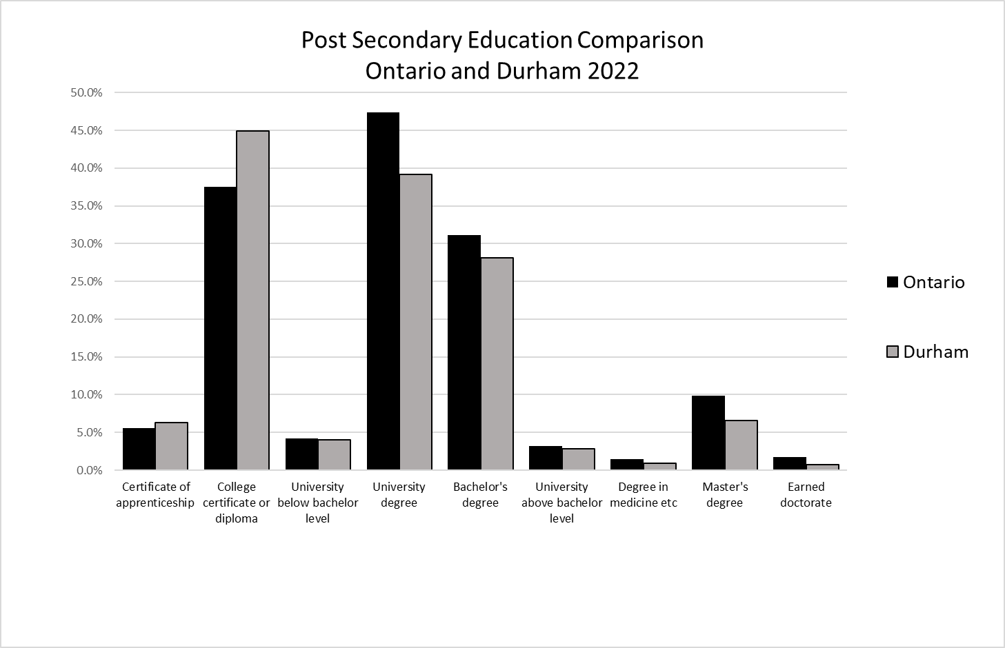
Education Data
Source Manifold

Slide 44
Education Data
Provincially >55% of persons 15 and older have post a secondary certificate, degree or diploma in 2022
In Durham the total is slightly lower at 54% with the highest rate in Whitby 58.3% and the lowest is in Brock Twp 46.4%
Provincially 17.3% have not received a High School diploma or certificate. Durham has a lower rate at 16% in 2022
The lowest rate is found in Whitby and Pickering with 13.6% not receiving a High school certificate or diploma

Slide 45
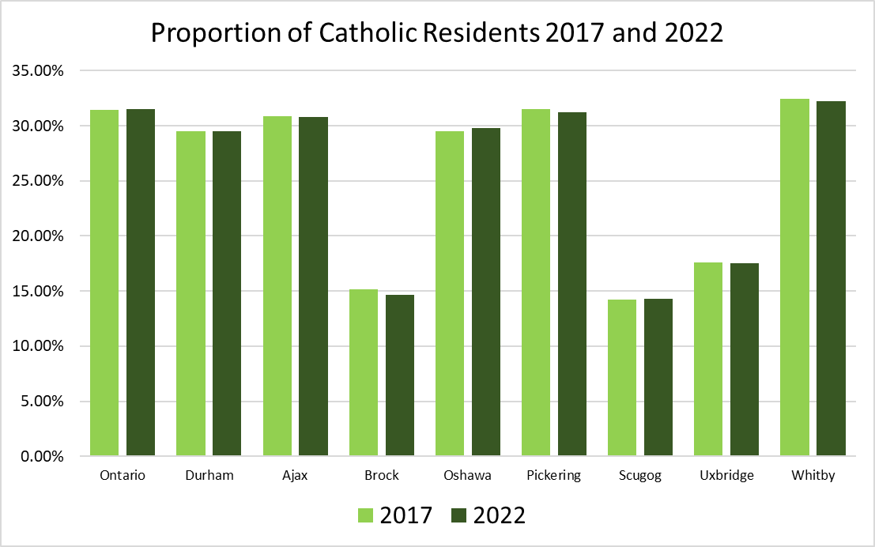
Catholicity
Religion refers to the person's self-identification as having a connection or affiliation with any religious denomination, group, body, sect, or other religiously defined community or system of belief. Religion is not limited to formal membership in a religious organization or group.
Source Manifold

Slide 46
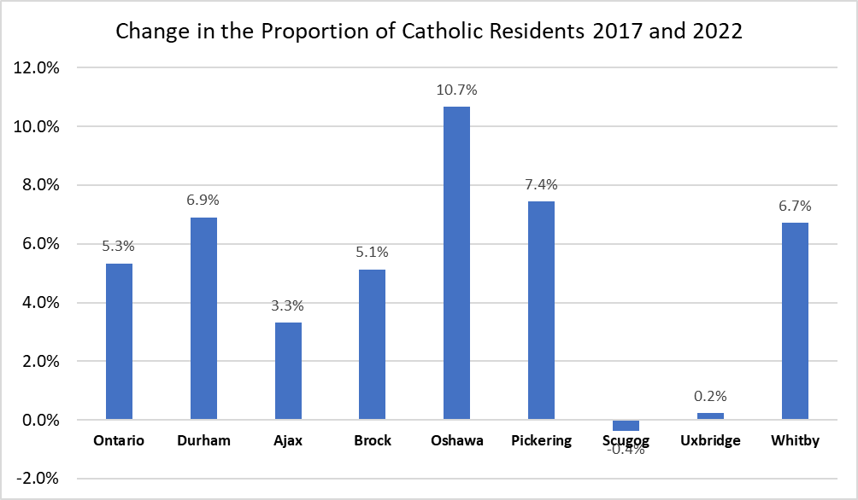
Catholicity
Source Manifold

Slide 47
Catholicity Data
The overall % of persons identifying as Catholic is 29% in Durham Region which is slightly smaller than the provincial average
Durham has its highest proportion of Catholic residents in Whitby and Pickering
The lowest proportions are in the northern three communities (Scugog, Brock, Uxbridge
The greatest increase in the proportion of Catholic residents from 2017-2022 is in Oshawa
The greatest reduction was in the Mississauga's of Scugog Island followed by the Township of Scugog

Slide 48
MISSION, VISION, VALUES
How do we evaluate and reaffirm our Board's Mission, Vision and Values as part of the process?

Slide 49

Mission

Slide 50
Draft Mission Statements
Three draft statement have been shared.
Please consider the following:
    Is it clear and concise?
    Does it identify our ultimate purpose?
    Is it inspiring?
    Does it clearly define who we serve and what we do?
For Each Statement
    What is Good?
    What is Missing?

Slide 51
Strategic Priorities

Slide 52

Strategic Priorities – All

Slide 53
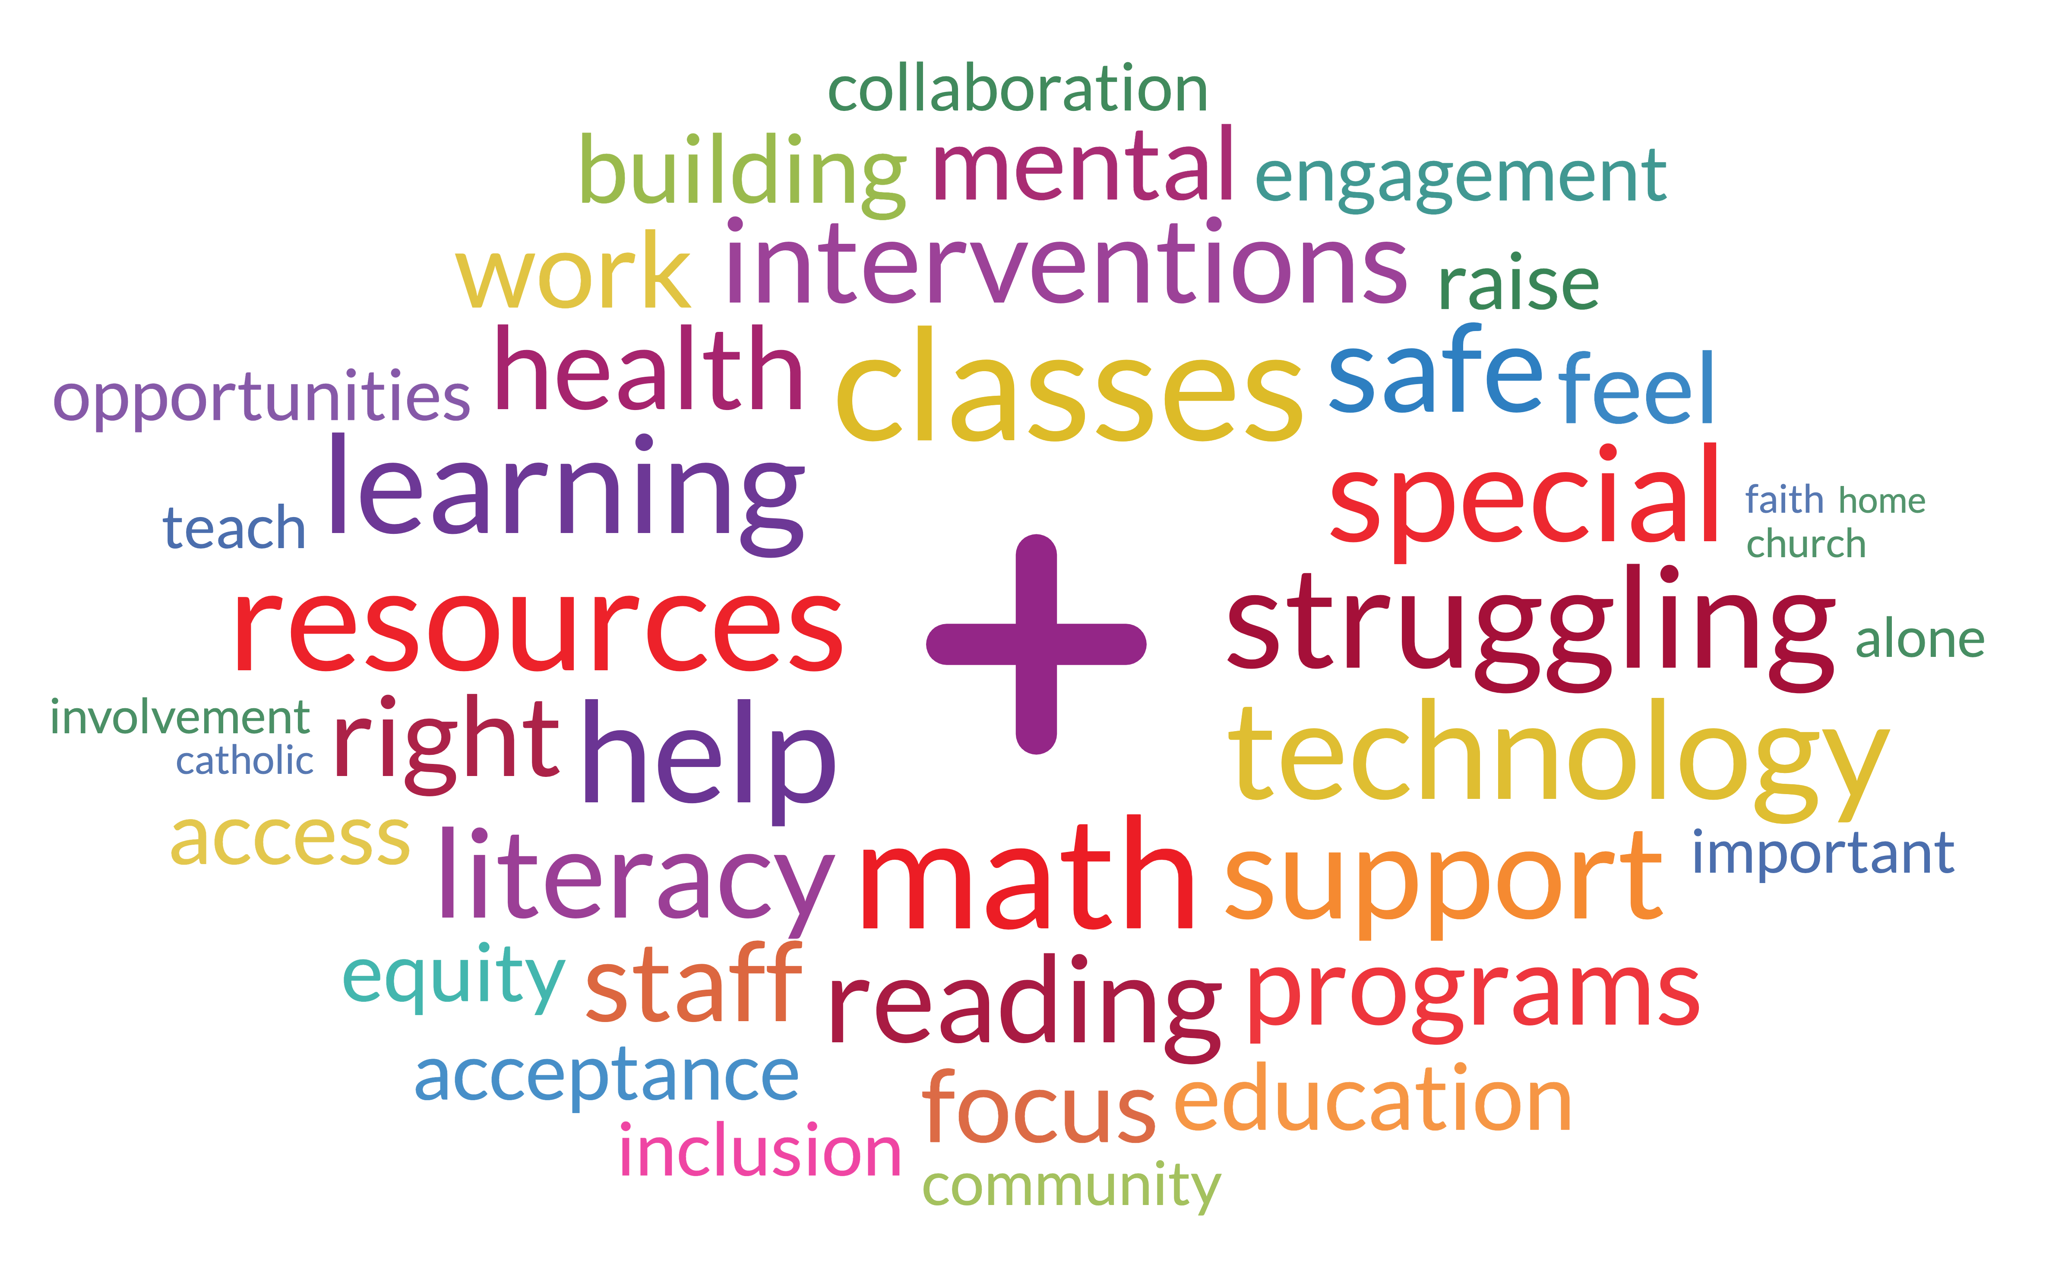
Strategic Priorities -Staff

Slide 54

Strategic Priorities - Parents/Guardians

Slide 55
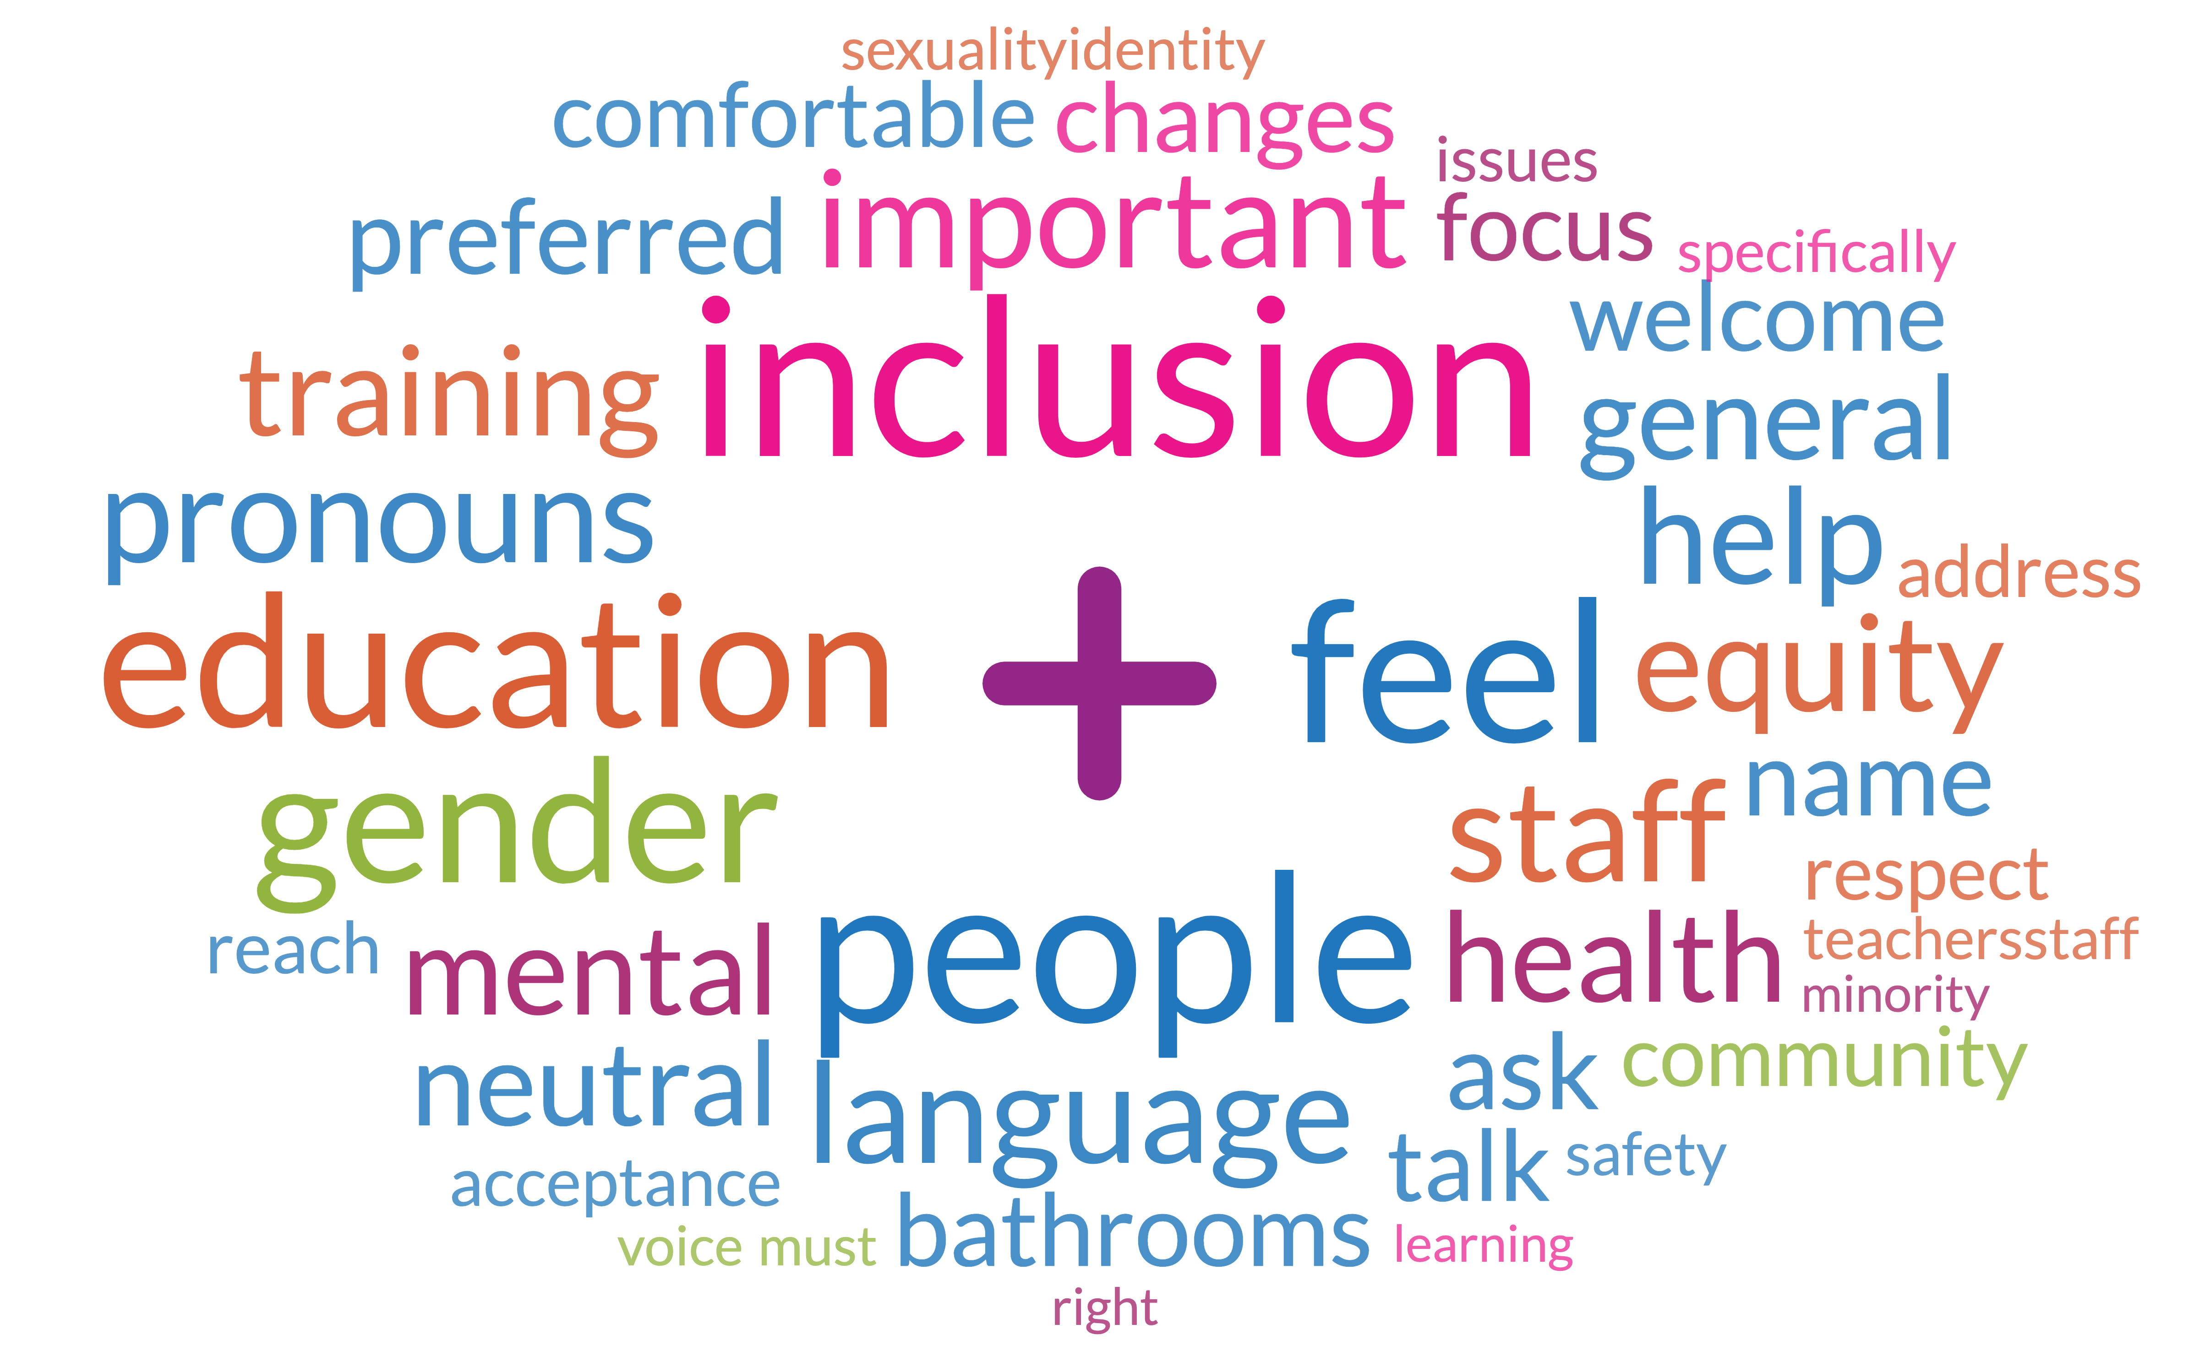
Strategic Priorities - Students

Slide 56



Mission statement by group
STAFF
PARENTS/GUARDIANS
STUDENTS

Slide 57
Emerging Areas of Focus
Faith Formation and Leadership – grounded in Catholic Social Teachings
Indigenous Education
Equity – Culturally Relevant and Responsive Practice and Pedagogy; Special Education; 2SLGBTQ+; Destreaming; Science of Reading; Representation; Resources
Experiential Learning - community connected, on the land, authentic
Professional Learning and Leadership Development
Stewardship for Creation

Slide 58
Strategic Priorities vs Strategic Goals
A strategic priority is an area of high importance that an organization establishes in order to realize its vision. A strategic priority provides a framework for organizing, defining and communicating strategic goals.
Strategic goals are what an organization will achieve over the course of its strategic plan. Strategic goals are achieved through the initiatives that an organization implements.

Slide 59
Emerging Ideas
Strategic priorities for the future need to:
Represent intentional action;
Provide a framework for responsive change;
Outline a commitment to a fundamental shift in the way we approach our work in order to achieve better, more equitable outcomes; and
Be applicable at all levels of the organization.

Slide 60
Proposed Framework
Listening
Learning
Living in Faith

Slide 61
The “Why”
Getting to the core of why we need to prioritize listening, learning and living in faith.

Slide 62
Listening
Create spaces and establish practices to listen (with the ears of the heart) to all the voices, and especially the most vulnerable to build understanding.
To listen to what our data tells us to identify areas of need.
To list to research and experts to inform our actions

Slide 63
Learning
Student Learning
  Culturally relevant and responsive
  De-streamed classes
  Science of Reading
  STEM – CODING
Professional Learning
  Timely and focused
  Culturally Relevant and Research Based
  Building Capacity to support students with special education needs
  Technical and adaptive

Slide 64
Living in Faith
Be Catholic learning communities that embody love and respect for the dignity and worth of each person
Be models of Truth and Reconciliation as we Walk the Path Together with the Indigenous community
Be stewards of creation
Enhance living AS learning – experiential, applicable, practical, on-the-land, in the community, authentic

Slide 65
Why should Listening be part of our framework?
Listening is essential to culturally responsive pedagogy (why?)
To be more equitable (why?)
To improve the experiences of marginalized students (why?)
Our data shows us that there are groups of students who are under served and who have systemic barriers to success (why?)
We want every student to be engaged and we want every student to succeed (why?)
So that we can dismantle the systemic barriers to success (why?)
Because our mission is to serve every student who is made in the image of God … and this mission is our calling and our vocation

Slide 66
NEXT STEPS

