Slide 1
Multi-Year Strategic Planning
MYSP Committee Meeting #5
Monday September 12, 2022

Slide 2
Land Acknowledgement
We here in the Durham Region respectfully acknowledge that we are on the traditional lands of the Mississauga's of Scugog Island.

Slide 3
Opening Prayer
Father, as we gather once again, we are thankful for our community and the time we have been given to be together. May your Holy Spirit guide our discussions and lead us as we discern a path to the future that will best serve the needs of the very precious gift that you have entrusted to our care, our students.​
​
Release us from the burden of our own egos. Give us eyes to see things not only as they are but as they should be, ears to hear all the voices, from the margins no less than from the center; hearts to listen to the needs, hopes and dreams of all whom we are called to lead and serve.​
​
O Holy Spirit, come and abide with us. Enliven us with your creative power; inspire us with your wisdom and understanding; Warm us with your love, so that we may live what we profess to believe and serve others with generous and cheerful hearts.​
We make our prayer in Jesus’ name.​ AMEN
​

Slide 4
MYSP Committee Workshop
5:00pm – 7:00pm
Pope Francis Center
Content For This Evening
Welcome
Land Acknowledgement
Opening Prayer
Review of Timelines, Processes and Progress to Date
Review of Draft Strategic Plan
Final Input and Recommendations

Slide 5
Members
Data and Research Officer
Richard DeCaires
Partner and Community Representatives:
Erin Troost, APSSP
David Dubowits, Chaplains
Melissa Vickery, CPCO
Dan Allen, CPCO
John Quarrie, CUPE Custodial/Maintenance
Maureen Cope, CUPE Educational Assistants
Sajida Aaron, CUPE LINC/ESL
Mike Morris, CUPE Secretarial/Clerical/Technical
Kelly Mulville, ETFO/DECE
Lori Jones, Management Administrative Group
Jaci French, OECTA Elementary
Paul Collicutt, OECTA Secondary
Valerie Adamo, Special Education Advisory Committee
Vanessa Asgarali, Durham Catholic Parent Involvement
Julie Pigeon, Indigenous Education Circle
Sean McCormack, ABR & BE Committee
Nicole Emanuel, ABR & BE Committee
Kelly Stephen, 2SLGBTQ+ Advisory Committee
Katherine Mustachi, Faith Formation
Diane Mullane, Mental Health Lead
Luetasha Watkins, Childcare Partners
Co-Chairs:
Morgan Ste. Marie, Chair of the Board
Tracy Barill, Director of Education
MYSP Facilitator:
Lewis Morgulis, L&C Planning Consultants
Communications:
Amanda Roffey, Faeron Pileggi, Emily McCall
Trustees, Clergy and Senior Admin:
John Rinella, Vice Chair of the Board
Monique Forster, Trustee
Janice Oldman, Trustee
Mikhail Yurkoski, Trustee
Declan Amaral, Student Trustee
Sophie Nwaoha, Student Trustee
Fr. Keith Callaghan, Archdiocese of Toronto
Kayode Akomolafe, Human Rights and Equity Advisor
Paula Sorhaitz, Superintendent of Education, Academic
Scott Grieve, Superintendent, Corporate

Slide 6
Why Are We Here?
Ontario Education Act, section 169.1(1)
Every board shall develop a multi-year plan aimed at:
promoting student achievement and well-being;
a positive school climate that is inclusive and accepting of all pupils,
the prevention of bullying and
the delivery of effective and appropriate education to its pupils.

Slide 7
Mandate of the MYSP Committee
Lead by Chair Ste. Marie and Director Barill, the mandate of the Multi-year Strategic Planning Committee will be to:
provide oversight and input into the planning process;
ensure opportunities for student, staff and community engagement;
provide feedback at key intervals; and
review the final draft plan to be recommended to the Board for approval.

Slide 8
The Multi-year Strategic Planning Process

Slide 9
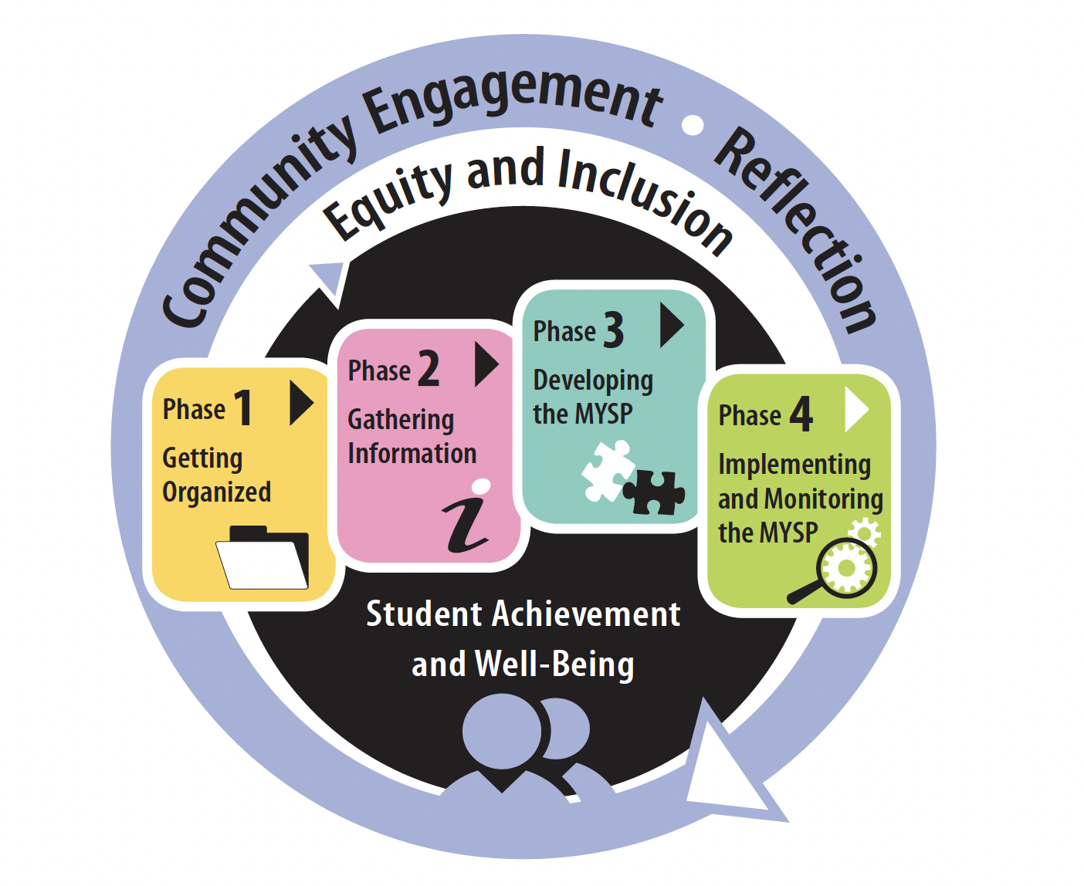
Project Plan
FEB | MAR | APR |  | MAY | JUNE | JULY | AUG | SEPT | OCT |  | NOV | DEC | JAN +
PHASE ONE – Getting Organized
PHASE TWO – Gathering Information
PHASE THREE – Developing the MYSP
PHASE FOUR – Implementing and Monitoring the MYSP

Slide 10
Proposed Timelines
Date | Audience/Participants | Activity
February 2022 | Senior Admin Board of Trustees | Session #1 – February 19, 2022 Report to Board - Establish a Committee – February 28, 2022
March 2022 | MYSP Committee Sr. Admin Working Session | Workshop/Retreat – March 23, 2022 March 30, 2022
April 2022 | Sr. Admin Working Session MYSP Committee Public /Stakeholders | April 5, 2022 April 19, 2022 (5:15pm – 6:45pm) Virtual Information Sharing
May 2022 | MYSP Committee Sr. Admin Working Session Public/Stakeholders | May 16, 2022 (5:15pm – 6:45pm) Virtual May 17, 2022 Community Engagement – May 30, 2022

Slide 11
Proposed Timelines
Date | Audience/Participants | Activity
June 2022 | Sr. Admin Working Session MYSP Committee Public/Stakeholders Sr. Admin Working Session | June 2, 2022 June 13, 2022 (5:15pm – 6:45pm) In Person Gather Feedback June 22, 2022
July-August 2022 | Communications/Director/Chair/ Facilitator | Content and Format
September 2022 | Senior Admin MYSP Committee Board of Trustees Senior Admin | August 18/19 and September 8, 2022 – Review Draft September 12, 2022 – Review Draft Review Draft – September 26, 2022 Final Revisions
October 2022 (Special Board meeting) | Board of Trustees | Early October - Final Approval
November /December | Communications | Communications Plan for Roll-out
January 2023 | DCDSB Community | Launch

Slide 12
What have we done?
Taken stock of our programs and services
Reviewed Internal Data Sources:
School Pastoral Plans
School Climate Surveys
Mental Health
Special Education Data
De-streamed Math Achievement Data
Pathways Data
Indigenous Education Data
Workforce Census Data

Slide 13
What have we done?
Identified critical work that needs to be done in the coming years in each area (Ministry, funding, data or mandate driven)
Focus on adult faith formation and leadership
De-streaming
Science of Reading
Culturally relevant and responsive pedagogy and practice
Indigenous Education
Modernization
Leadership and succession planning
Re-build community
Re-establish financial reserves
Capital Renewal
Employment Systems Review

Slide 14
What have we done?
External/Environmental Scan
Census/Demographics for Durham Region/Ontario
Strategic Plans for other Boards and Related Agencies
Ministry Priorities
Economic Factors

Slide 15
What have we done?
Offered opportunity for engagement of students, families, staff and community members through:
Focus Group Sessions
Virtual Town Hall Meetings
Staff Drop In Sessions
Advisory Group Meetings (DCPIC, Student Senate, SEAC, ABR&BE, Indigenous Education Circle, 2SLGBTQ+ Student Summit)
Two Thought Exchanges during the month of May (1100+ participants and 14700 ratings)

Slide 16
What have we done since June
Finalized the renewed Mission, Vision and Values
Reviewed and refined strategic priorities and goals
Reviewed and refined approach to monitoring performance
Prepared a draft of the plan for review with the MYSP Committee
Worked with graphic designers on layout

Slide 17
Communications
Dedicated Website Page
Sent links and updates to all families through DCDSB News
Sent links and updates to all staff through The Weekly Buzz
Videos
Live Virtual Sessions
Voice over powerpoints
Pamphlets
Board Meeting Speaking Notes, Reports and Highlights

Slide 18
MISSION, VISION, VALUES
Lets review our draft Board's Mission, Vision and Values

Slide 19
Mission – What we heard

Slide 20
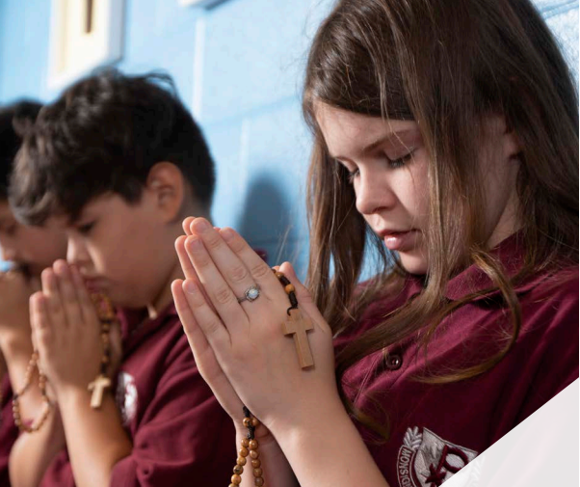
Mission
We are an inclusive Catholic learning community that inspires every student to achieve their full potential through faith and education.

Slide 21
Vision
By fostering positive relationships with home, school, parish and community, students and staff will learn and work in a Catholic environment where they feel:
Safe and welcome
Accepted and valued
Heard and engaged
Supported and prepared

Slide 22
Values
Faith
Hope
Home
School
Our
Students
Parish
Reconciliation
Love
Respect
Charity

Slide 23
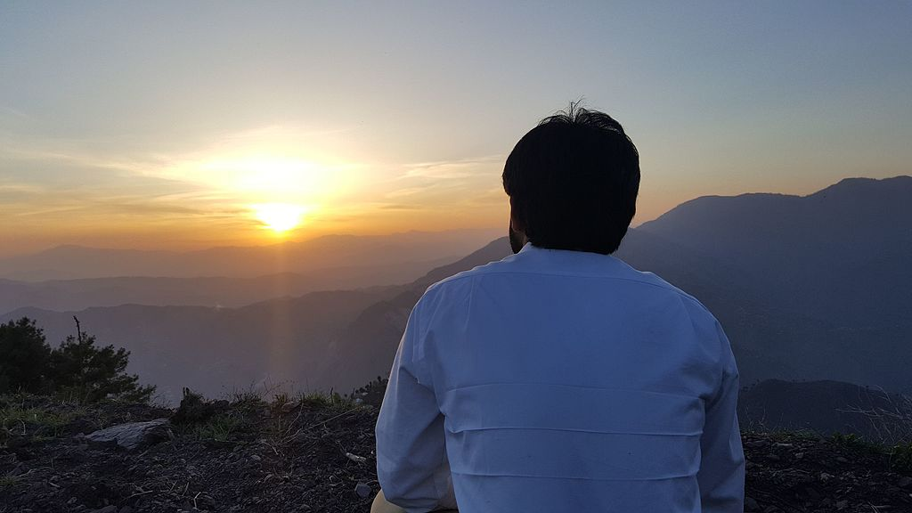
Take time to reflect

Slide 24
Listening, Learning and Living in Faith 2023-2026

Slide 25
Our Plan at a Glance
Listening, Learning and Living in Faith are foundational processes that form the core of our Multi-year Strategic Plan. Through the intentional implementation of these processes, annual goals will be developed and implemented under the strategic priorities of:
Supporting Faith and Well-Being
Advancing Human Rights and Equity; and
Improving Student Learning.

Slide 26
Listening
“It is only by paying attention to whom we listen, to what we listen, and to how we listen that we can grow in the art of communicating, the heart of which is not a theory or a technique, but the ‘openness of heart that makes closeness possible’.” – Pope Francis
To achieve our strategic priorities, we must foster the art of listening to our students, staff, families, parishes, and community partners. By listening to the diverse needs of our communities, reviewing our data and accessing research, we can dismantle systemic barriers to success and provide more equitable and engaging learning environments for students.

Slide 27
Learning
“Show me your ways, LORD, teach me your paths. Guide me in your truth and teach me, for you are God my Savior, and my hope is in you all day long.” – Psalms 25:4-5
We are a learning organization. Our commitment to providing positive and welcoming learning environments for students is mirrored in our commitment to engaging staff in timely and culturally relevant professional learning. To achieve our strategic priorities, our multi-year strategic plan focusses on learning that is faith-based, culturally responsive, data driven and grounded in research.

Slide 28
Living in Faith
“Faith and performing good works for your fellow man go together like body and soul. You simply aren’t alive unless both body and soul are united.” (James 2:26)
Listening and learning are fruitless in the absence of action. As partners in Catholic education we are called to live in ways that authentically represent our faith. We are guided in our actions by the Gospel values of Jesus Christ and the Social Teachings of the Catholic Church. We are called to demonstrate our faith through charitable works and service. By living in faith, students and staff will support faith and well-being, advance human rights and equity and improve student learning.

Slide 29
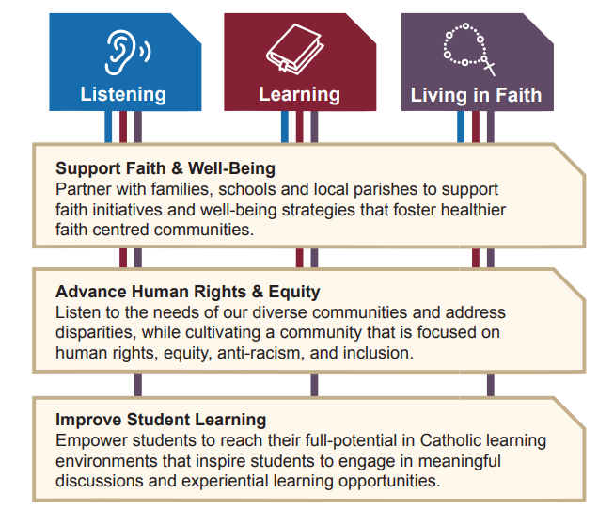

Slide 30
Take time to reflect

Slide 31
Our Performance
Understanding our current environment and context
Need for system agility and responsivity
Implementation – through annual operational plans that outline:
Specific goals;
Strategies; and
Expected Outcomes
These operational plans will be developed using the framework of the MYSP and may include Ministry driven initiatives. Performance measures connected to each goal will be identified annually.

Slide 32
Monitoring our Performance
Implementation | Were timelines/targets met? How well did we implement the identified strategies? How do we know?
Impact | What has changed as a result of the actions taken? Who/what was affected? Were there any unintended outcomes?
Insights | What have we learned? What new questions/ideas have emerged? What are our next steps?

Slide 33
Examples of mandatory operational and action plans required by the Ministry and/or Board that relate to and further define the Board’s strategic direction
Board and School Improvement and Equity Plans Board and School Pastoral Plans Board Mental Health Action Plan Staff Wellness Action Plan Bullying Prevention and Intervention Plan Board Equity Action Plan Human Rights and Equity Advisor Report Indigenous Education Board Action Plan Special Education Plan Budget and Strategic Priorities Document DCDSB Sustainability Plan Biennial Accessibility Plan Long-term Accommodation and Capital Plan Multi-Year Technology Plan Special Education Plan FSL 3 Year Plan General Emergency Preparedness Response Plan Business Continuity Plan

Slide 34
Examples of quantitative and qualitative data sources to inform planning and monitor outcomes
Board Equity Audit Board Mental Health Scan (quarterly data) Course Selection Data Credit Accumulation Cyber Security Data Early Development Index Data EcoSchools Certification Enrolment data and projections Environmental conservation data Exit Surveys HR Data (e.g. absenteeism, health claims, disability claims) Human Rights Complaints Reporting Data Indigenous Self-Identification Data Parent Engagement Survey Data | Participation rates in wellness initiatives Report Card Data Risk mitigation. School Climate Survey Data Survey Data Suspension/Expulsion Data Student Assessment Data Student Attendance Data Student Demographic Data Student Voice Data (gathered through advisory groups, thought exchanges, forums, summits) Training and PD feedback forms Completion Data, incident rates (SCBI reports) Workforce Demographic Data/Employment

Slide 35
Take Time to walk along the gallery and post your thoughts on each section

Slide 36
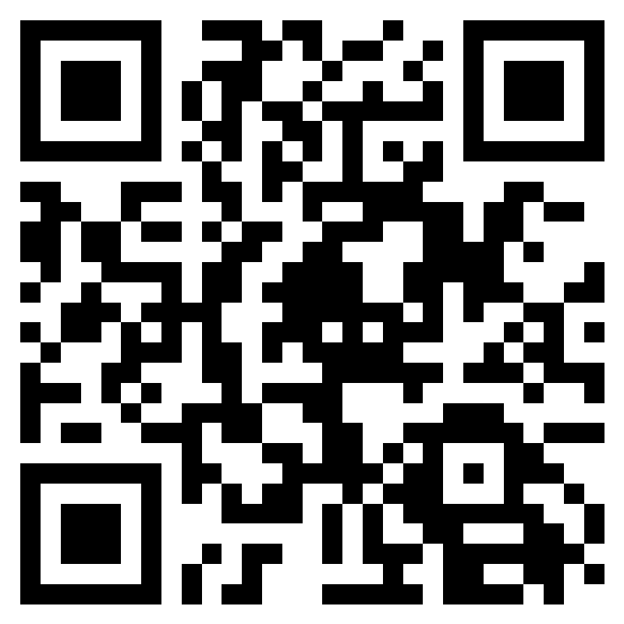
Feedback and Final Comments
Please take a moment to complete our feedback survey.
Your feedback is anonymous, however, if you wish to included your name you will have an opportunity to do so at the end.
https://dcdsb.ca/MYSPfeedback

Slide 37
Next Steps

Slide 38
Closing Prayer
Almighty God, we thank you for this beautiful day.
Thank you for enabling us to be productive during the meeting.
Lord, let what we discussed here bear fruit in our lives and in the lives of all those we serve, especially our students.
As we depart, Lord, we ask you to be with us. May your angels go before us and clear the way so that we can reach home safely. May all glory and honor come back to you in everything that we do.
In Jesus’ name we believe and pray, Amen.

