Slide 1
Multi-Year Strategic Planning
MYSP Committee Meeting #4
Monday May 16, 2022

Slide 2

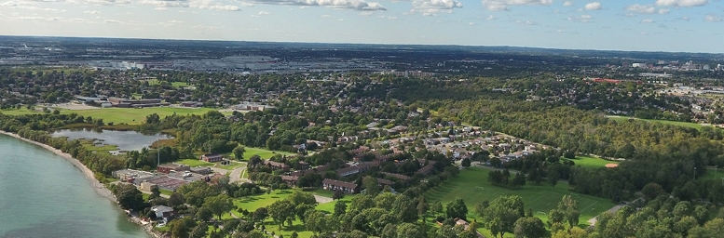
Land Acknowledgement
We here in the Durham Region respectfully acknowledge that we are on the traditional lands of the Mississaugas of Scugog Island.

Slide 3
Opening Prayer
Father, as we gather together today, we are charged with finding a path to the future that will best serve the needs of the very precious gift that you have entrusted to our care, our students.
Release us from the burden of our own egos. Give us eyes to see things not only as they are but as they should be, ears to hear all the voices, from the margins no less than from the center; hearts to listen to the needs, hopes and dreams of all whom we are called to lead and serve.
O Holy Spirit, come and abide with us. Enliven us with your creative power; inspire us with your wisdom and understanding; Warm us with your love, so that we may live what we profess to believe and serve others with generous and cheerful hearts.
We make our prayer in Jesus’ name.
Adapted from the OCSOA Prayer

Slide 4
MYSP Committee Workshop
5:15pm – 6:45pm - Virtual
Content For This Evening
  Welcome
  Land Acknowledgement
  Opening Prayer
  Review of Mandate and Timelines
  Internal scan of programs, practices and human resource investments
  Review of Mission and Values
  Next Steps

Slide 5
Members
Data Analyst
Richard DeCaires
Partner and Community Representatives:
Erin Troost, APSSP
David Dubowits, Chaplains
Melissa Vickery, CPCO Elementary
Paula Sorhaitz, CPCO Secondary
John Quarrie, CUPE Custodial/Maintenance
Maureen Cope, CUPE Educational Assistants
Sajida Aaron, CUPE LINC/ESL
Mike Morris, CUPE Secretarial/Clerical/Technical
Kelly Mulville, ETFO/DECE
Lori Jones, Management Administrative Group
Jaci French, OECTA Elementary
Paul Collicutt, OECTA Secondary
Valerie Adamo, Special Education Advisory Committee
Vanessa Asgarali, Durham Catholic Parent Involvement
Julie Pigeon, Indigenous Education Circle
Sean McCormack, ABR & BE Committee
Nicole Emanuel, ABR & BE Committee
Kelly Stephen, 2SLGBTQ+ Advisory Committee
Katherine Mustachi, Faith Formation
Diane Mullane, Mental Health Lead
Luetasha Watkins, Childcare Partners
Co-Chairs:
Morgan Ste. Marie, Chair of the Board
Tracy Barill, Director of Education
MYSP Facilitator:
Lewis Morgulis, L&C Planning Consultants
Communications:
Amanda Roffey, Faeron Pileggi, Emily McCall
Trustees, Clergy and Senior Admin:
John Rinella, Vice Chair of the Board
Monique Forster, Trustee
Janice Oldman, Trustee
Mikhail Yurkoski, Trustee
Declan Amaral, Student Trustee
Sophie Nwaoha, Student Trustee
Fr. Keith Callaghan, Archdiocese of Toronto
Kayode Akomolafe, Human Rights and Equity Advisor
Mariah O’Reilly, Superintendent of Education, Academic
Scott Grieve, Superintendent, Corporate

Slide 6
WHY ARE WE HERE?

Slide 7
Why Are We Here?
Ontario Education Act, section 169.1(1)
  Every board shall develop a multi-year plan aimed at:
  promoting student achievement and well-being;
  a positive school climate that is inclusive and accepting of all pupils,
  the prevention of bullying and
  the delivery of effective and appropriate education to its pupils.

Slide 8
WHAT ARE WE GOING TO DO?

Slide 9
Mandate of the MYSP Committee
Lead by Chair Ste. Marie and Director Barill, the mandate of the Multi-year Strategic Planning Committee will be to:
  provide oversight and input into the planning process;
  ensure opportunities for student, staff and community engagement;
  provide feedback at key intervals; and
  review the final draft plan to be recommended to the Board for approval.

Slide 10
Role of Senior Administrative Team
Working committee ultimately responsible for development of the key themes, goals and format of the renewed Multi-year Strategic Plan
Representatives of Senior Admin on the MYSP Committee
Will develop the plan and bring forward information for discussion and feedback from the MYSP Committee based upon a thorough review of:
  Internal and External Data Analysis
  Ministry priorities, funding allocations and local needs
  Community and Partner Engagement and Feedback

Slide 11
Role of the Board of Trustees
Ultimately the Board of Trustees is the governing body of Durham Catholic District School Board.
Trustees will keep apprised of the multi-year strategic planning process through regular reports to Board
Final approval of the new Multi-Year Strategic Plan rests with the Board of Trustees

Slide 12
Supports for the Process
Process Facilitator and Consultant
  Lewis Morgulis – L&C Planning Consultants
Communications Department
  Amanda Roffey, Senior Manager
  Faeron Pileggi, Communications Officer
  Emily McCall, Digital Media
Data Analyst
  Richard DeCaires
Community Engagement and Feedback Platforms
  Advisory Groups
  Focus Groups
  Thought Exchange
  Board Website and Dedicated Email

Slide 13
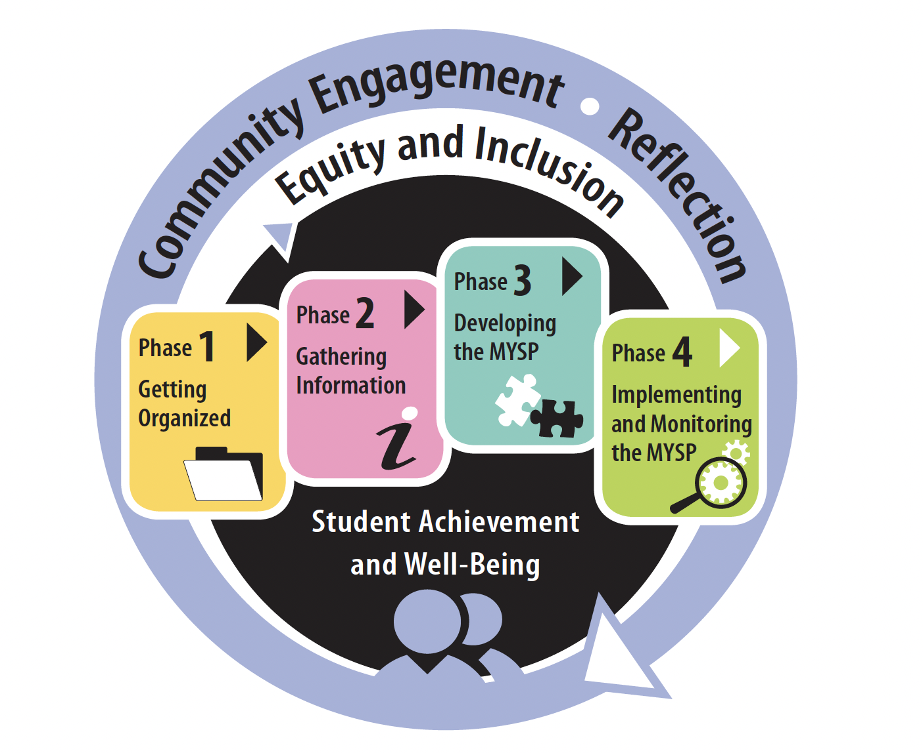
The Multi-year Strategic Planning Process

Slide 14
Project Plan
FEB | MAR | APR |  | MAY | JUNE | JULY | AUG | SEPT | OCT |  | NOV | DEC | JAN +
PHASE ONE – Getting Organized
PHASE TWO – Gathering Information
PHASE THREE – Developing the MYSP
PHASE FOUR – Implementing and Monitoring the MYSP

Slide 15
Proposed Timelines
Date | Audience/Participants | Activity
February 2022 | Senior Admin Board of Trustees | Session #1 – February 19, 2022 Report to Board - Establish a Committee – February 28, 2022
March 2022 | MYSP Committee Sr. Admin Working Session | Workshop/Retreat – March 23, 2022 March 30, 2022
April 2022 | Sr. Admin Working Session MYSP Committee Public /Stakeholders | April 5, 2022 April 19, 2022 (5:15pm – 6:45pm) Virtual Information Sharing
May 2022 | MYSP Committee Sr. Admin Working Session Public/Stakeholders | May 16, 2022 (5:15pm – 6:45pm) Virtual May 17, 2022 Community Engagement – May 30, 2022

Slide 16
Proposed Timelines
Date | Audience/Participants | Activity
June 2022 | Sr. Admin Working Session MYSP Committee Public/Stakeholders Sr. Admin Working Session | June 2, 2022 June 13, 2022 (5:15pm – 6:45pm) Virtual Gather Feedback June 22, 2022
July-August 2022 | Communications/Director/Chair/ Facilitator | Content and Format
September 2022 | Senior Admin MYSP Committee Board of Trustees Senior Admin | Review Draft - TBD Review Draft - TBD Review Draft – September 26, 2022 Final Revisions - TBD
October 2022 (Special Board meeting) | Board of Trustees | Final Approval
November /December | Communications | Communications Plan for Roll-out
January 2023 | DCDSB Community | Launch

Slide 17
What Have we done since the last meeting

Slide 18
Program Review
Taking stock of the range of programs, practices and staffing investments is essential as we have to know what we are already doing and whether or not it is:
Required,
Relevant and,
Being effectively delivered
The Board should have an understanding of the requirements to have the programs that we currently operate, understand the original and current program aims, and then have some measure to assess whether they are effective or not.

Slide 19
Student Learning and Innovation
Specialized Programs
Specialist High Skills Majors (SHSM) | Catholic Return Ticket
K-12 International Languages | Alternative Education
Advanced Placement (AP) Courses | Continuing Education
Summer School | Night School
Intermediate Guidance Teams (IGT) | Dual Credits
Supervised Alternative Learning (SAL) | Tutoring
Prior Learning Assessment Recognition (PLAR) | Student Success Teams
Cooperative Education | Ontario Youth Apprenticeship (OYAP)
Literacy/Numeracy after school | EDSBY – Online Learning Platform
Science, Technology, Engineering and Math (STEM) Programs

Slide 20
Student Learning and Innovation
Programs Structures or initiatives designed to support vulnerable/equity deserving groups
Coach Advocates for Black Students | Framework – Incidents of Racism and discrimination | Indigenous Education Team Indigenous Education Advisory Circle Student Indigenous Education Advisory Circle
Anti-Black Racism and Black Excellence Advisory Committee | Early Intervention Classes - EIC courses | NBE Grade 11 Course – Contemporary Indigenous Voices
2SLGBTQ+ Advisory Committee | Human Rights and Equity Advisor | Canada World Studies/ Social Studies programs
Student Census | Anti-Black Racism Course Pilot – Deconstructing Anti-Black Racism in the Canadian Context | Days of Recognition Inquiry based/On the land Indigenous Learning
De-streaming | Behavior Resource Team
Rose of Durham credits for young parents | Durham Catholic Autism Resource Team | Community Partnerships
Right to Read | Behaviour Support Specialists | Indigenous Languages
Individual Education Plan (IEP) Process | Special Education Advisory Committee (SEAC) | Days/Weeks of Recognition
Science of Reading | Student Success Teams
Project Search | Therapeutic Recreation in Schools
Opportunities for Black Students in summer programs or STEM | Recruitment Plan

Slide 21
Student Learning and Innovation
Regional Programs
French Immersion (FI) | Early ON Centres – Early Years
Arts and Media Program (AMP) | Smart Start Hubs
Science, Technology, Engineering and Math (STEM) | Language Instruction for Newcomers to Canada (LINC)
Academy for Student Athlete Development | Learning Basic Skills (LBS)
Eco Schools | English as a Second Language Settlement Workers in Schools
Robotics | Heritage Language
International Education | Continuing Education – PSW program
Child Care

Slide 22
Well-Being
Safe Schools and Positive Climate | Supports for Mental Health and Well-Being
 | Disability Management (Employees)
Restorative Practices | Suicide Prevention Interaction
Safe Schools Teams site | Mental Health Steering Committee
Prevention/Intervention Awareness Weeks Report It Button (anonymous reporting) | Team Site Resources Days of Recognition and Awareness (ex. Black Mental Health Day, Bell Let’s Talk Day)
Joint Occupational Health and Safety Committee (JOHSC) | Extra-Curricular activities (LOSSA/OFSSA)
Crisis Response Teams | Wellness Committee
Covid Health and Safety Measures | Social workers
School Climate Survey Data | ASIST – Applied Suicide Intervention Skills Training
 | VTRA – Violent Threat Risk Assessment
OPHEA, STAO and OCTE training for Physical Education and Technological Education | Community Connections
Student Injury Prevention | Tier 1 Supports
 | Child and Youth Councillor Programs
 | AIM – Mental Health Supports Model
 | SMHO – School Mental Health Ontario Resources
 | Communications – The Buzz

Slide 23
Faith and Staff Development
Faith Formation |  | Staff Development
Specialized staffing for Faith | Celebrations of Faith | Professional Activity Days
Senior Manager of Faith Formation | Liturgies | New Teacher Initiation Program (NTIP)
Religion Consultants | System/School Masses | Onboarding/Performance Evaluation Mandatory Health and Safety Training
Bishops designate from the Archdiocese | Staff Retreats | Sharing of Excellence Seminars
School Chaplains | Sacramental preparation and support | System Level Webinars
Faith Ambassadors | Catholic Education Week | Aspiring Leaders program
Audit of our Faith Imagery | Monthly assemblies | VP Leadership series
Pastoral Plans for every school | Social Justice Initiatives | Mentoring for Principals and Vice Principals
Religion and Family Life Programs | Faith Ambassadors | Staff training for Anti-racism and Anti-Discrimination Threat Assessment and Response training Program and Curriculum based educator training
Catholic Children’s Foundation | ShareLife

Slide 24

Breakout Activity
Please join the zoom breakout room to discuss the programs, practices and staffing investments for the next 15 minutes.
Each group will have a designated facilitator to guide the discussion and report back to the big group.

Slide 25
MISSION, VISION, VALUES
How do we evaluate and reaffirm our Board's Mission, Vision and Values as part of the process?

Slide 26
DCDSB Mission Statement
We are called to celebrate and nurture the God-given talents of each student as we serve with excellence in the light of Christ.

Slide 27
The Mission Statement must answer three questions:
  What is our board’s ultimate purpose?
  What does our board do?
  Who does our board serve?

Slide 28
DCDSB Mission Statement
We are called to celebrate and nurture the God-given talents of each student as we serve with excellence in the light of Christ.

Slide 29
The Board’s values must address this question:
  What are our board’s essential and enduring beliefs?

Slide 30
Breakout Activity
Please join the zoom breakout room to discuss the Mission and Values for the next 25 minutes

Slide 31
NEXT STEPS

Slide 32
Project Plan
FEB | MAR | APR |  | MAY | JUNE | JULY | AUG | SEPT | OCT |  | NOV | DEC | JAN +
PHASE ONE – Getting Organized
PHASE TWO – Gathering Information
PHASE THREE – Developing the MYSP
PHASE FOUR – Implementing and Monitoring the MYSP

Slide 33
Phase 2 – Gathering Information
STAGE ONE – Data Collection and Analysis
1. Data Collection
  Internal scan (What data do we have? What data do we need?)
  External Scan (What forces are at play externally?)
2. Data Analysis
  Find themes and outliers
  Identify tentative strategic priorities

Slide 34
Phase 2 – Gathering Information
STAGE TWO - Formal Stakeholder Engagement
  Identify the stakeholders
  Determine the engagement approach and questions
  Conduct the engagements
  Analyze the findings
    Find the themes and outliers
    Compare the stakeholder feedback to the research data

Slide 35
Future Meetings
Meetings of the MYSP are planned for the following dates from 5:15 p.m. to 6:45 p.m.
  May16, 2022
  June 13, 2022
  A final meeting will be scheduled in early September 2022.

